Slide 1
Lecture 10
The differences between cities, inequality and dynamical processes
10.1 Statistical Distributions of Urban Quantities, Inequality, stochastic processes
IUS 4.2
©Luís M. A. Bettencourt 2024
Notes:
This module takes us on a detour, motivated by (student) interest in economic inequality. We will connect this to variation in income distributions at the neighborhood level in 10.3, and with some of the mechanisms and modeling for wealth dynamics and the statistics of urban quantities in 10.2.

Slide 2



Happy “World Cities Day 2024”

Slide 3
We want to explain why deviations from scaling for each city
have the observed distribution (~lognormal)
This is connected to how resources and information are used, at the individual and firm levels
and brings in the problems of growth and inequality
Bell-curve in logs
Notes:
This is where we are going with it, though this module is quite standard in terms of economic (wealth, income) inequality, we want to get to the statistics of urban quantities and its origins.

Slide 4
Inequality and statistics of variation in cities
Resources
Information
common problem in all complex systems
wealth, “social capital”
knowledge, expertise
IUS Ch 6
IUS Ch 5
Neighborhoods
(Spatial sorting)
Professions/Businesses
Inequality by:
Ethnicity, Race, SES
Class, Caste, Income
Notes:
All complex systems - from organisms to cities - can be thought in terms of the interdependent dynamics of resources (energy, wealth) and information. Resources are necessary and make action possible (ultimately because of the second law of thermodynamics); information characterizes choices: what is possible and what is observed as behavior. We will look at different aspects of this general picture in cities.

Slide 5

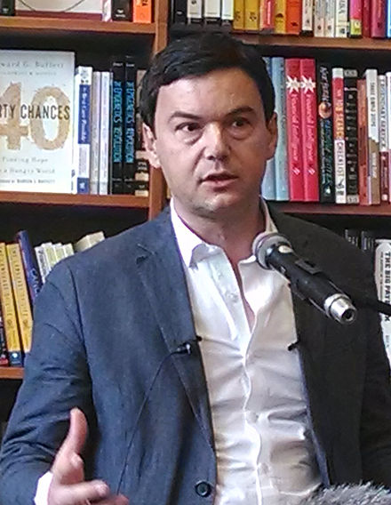
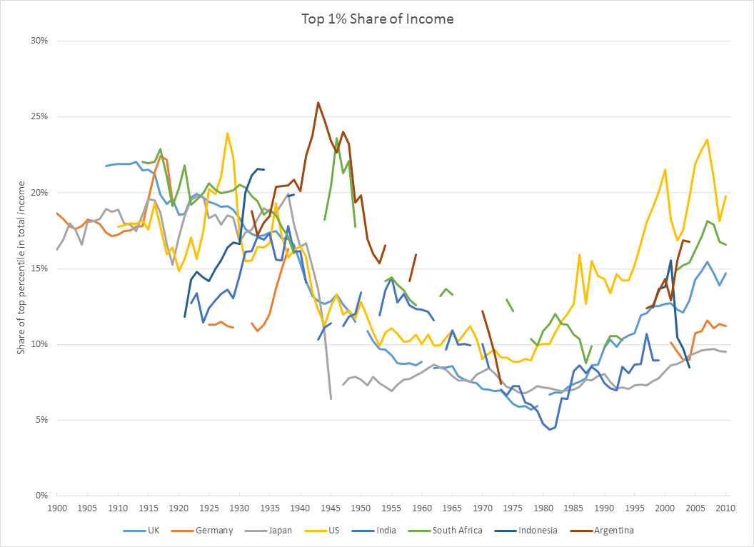
The Classic Approach to Economic Inequality
nations
Thomas Picketty
2013
Notes:
To motivate us, here is a quite famous picture about changes in inequality (here top 1% share of total income) over time. As is well known, the post WWII period saw low inequality because of growth, expansion of services, and progressive policies. This situation has bee inverting since the early 1980s, with dire consequences by now.

Slide 6
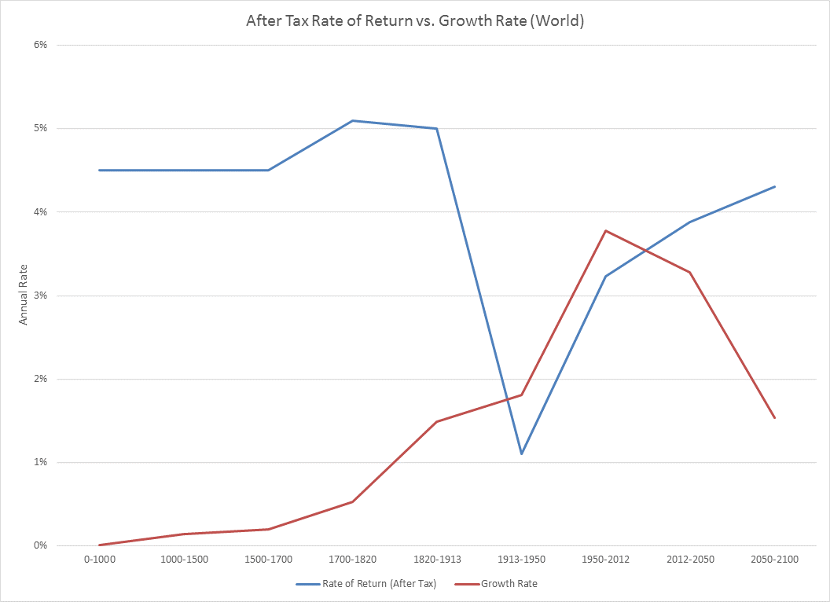
unknown
mostly land
postwar
20th century
s= return rate on capital
Harrod-Domar-Solow Formula:
$$\frac{wealth}{income}=\frac{s}{g}$$
g= growth rate of the economy
mostly “return on wages”
Notes:
Piketty argues - in a very aggregated way- that this is because of lower returns to wages than to capital in periods when inequality increases. So, in effect, it is not because of aggregate wealth production per se, but rather its diverging payoffs to capital versus labor.

Slide 7
But many sources and forms of inequality…
Notes:
Inequality is not a well defined quantity, and can be measured in many different ways. It is related to the width (~ variance) of a distribution, but because wealth and income distributions can be very skewed, this leads to different measures.

Slide 8


Notes:
This is another important voice on what happened in detail to the US economy over the last few decades.

Slide 9
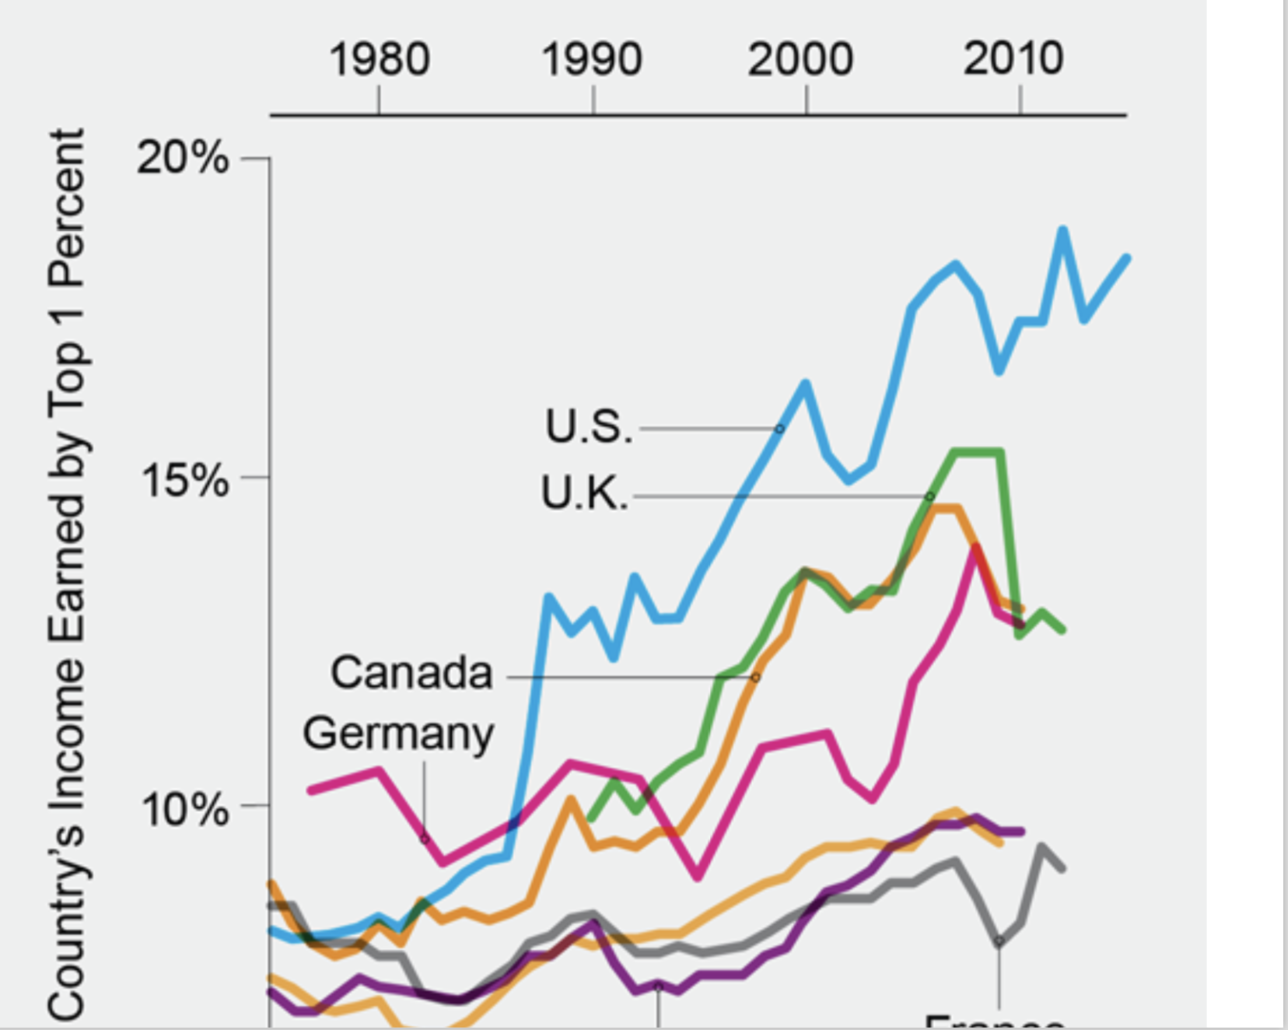
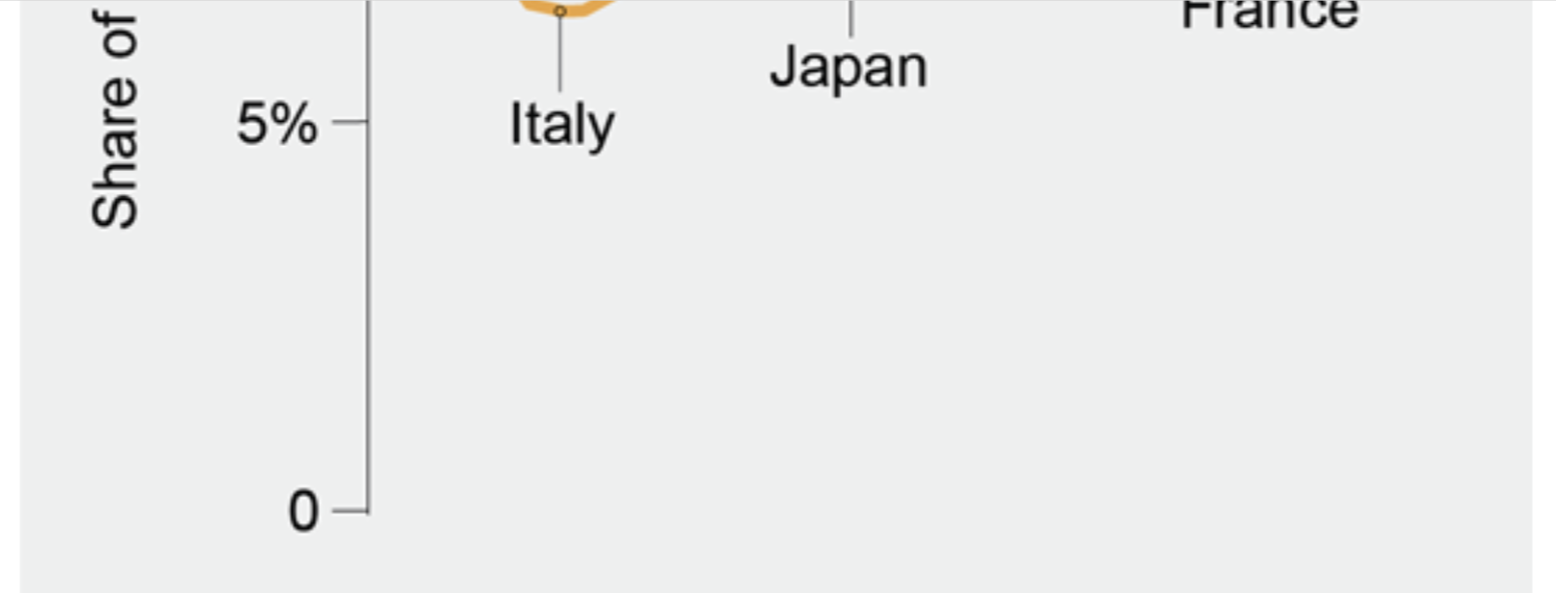
credit: Stiglitz, Scientific American (2018)
Notes:
So, the US is much worse in producing inequality over this period. Inequality production is not inevitable …

Slide 10
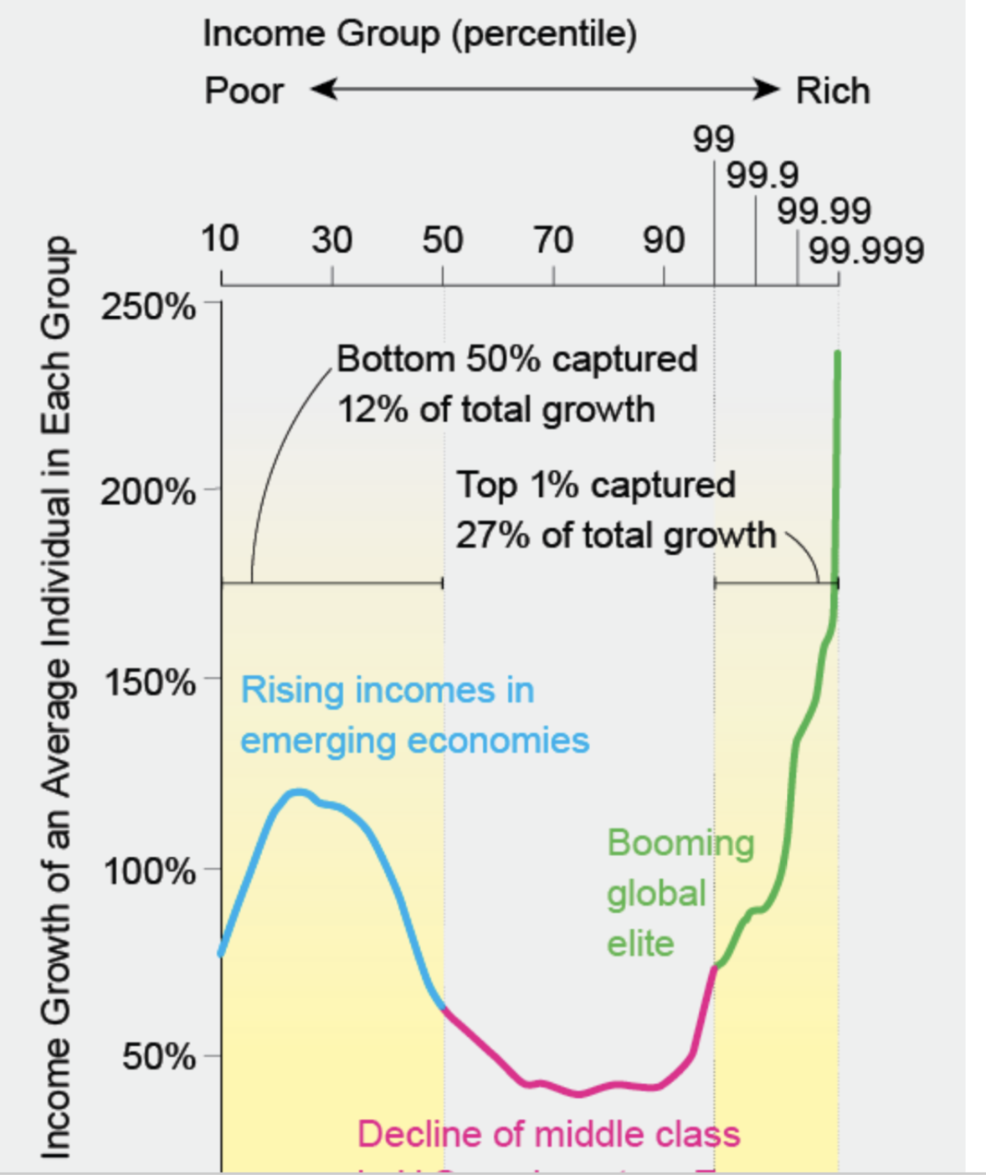

between 1980-2016
income = wages + capital rents
credit: Stiglitz, Scientific American (2018)
Notes:
This shows a different facet of the phenomenon, that the middle class was the least favored in terms of growth of income, with the highest incomes seeing the largest increases.

Slide 11
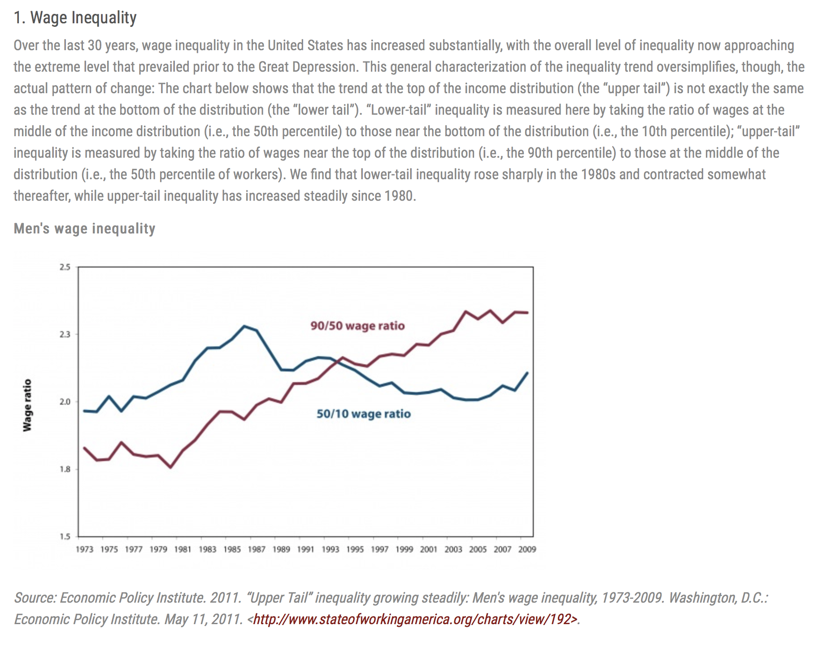
Nation wide
20 Facts About U.S. Inequality that Everyone Should Know
Notes:
Just other ways to measure aspects of the phenomenon, in the national aggregate…

Slide 12
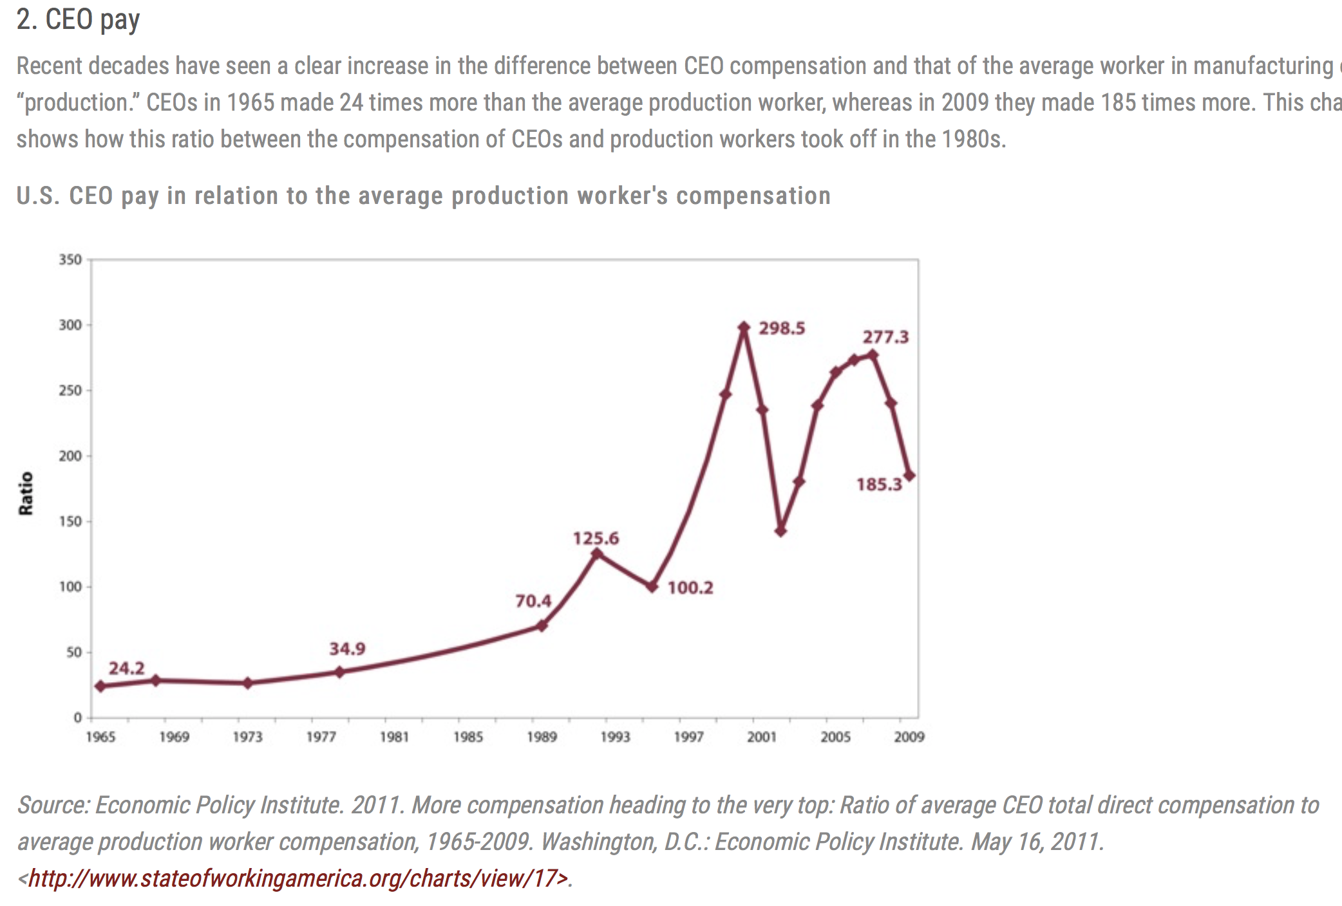
Within firms
from: 20 Facts About U.S. Inequality that Everyone Should Know
20 Facts About U.S. Inequality that Everyone Should Know
Notes:
This is one of the important reasons, that inequality within firms exploded.

Slide 13
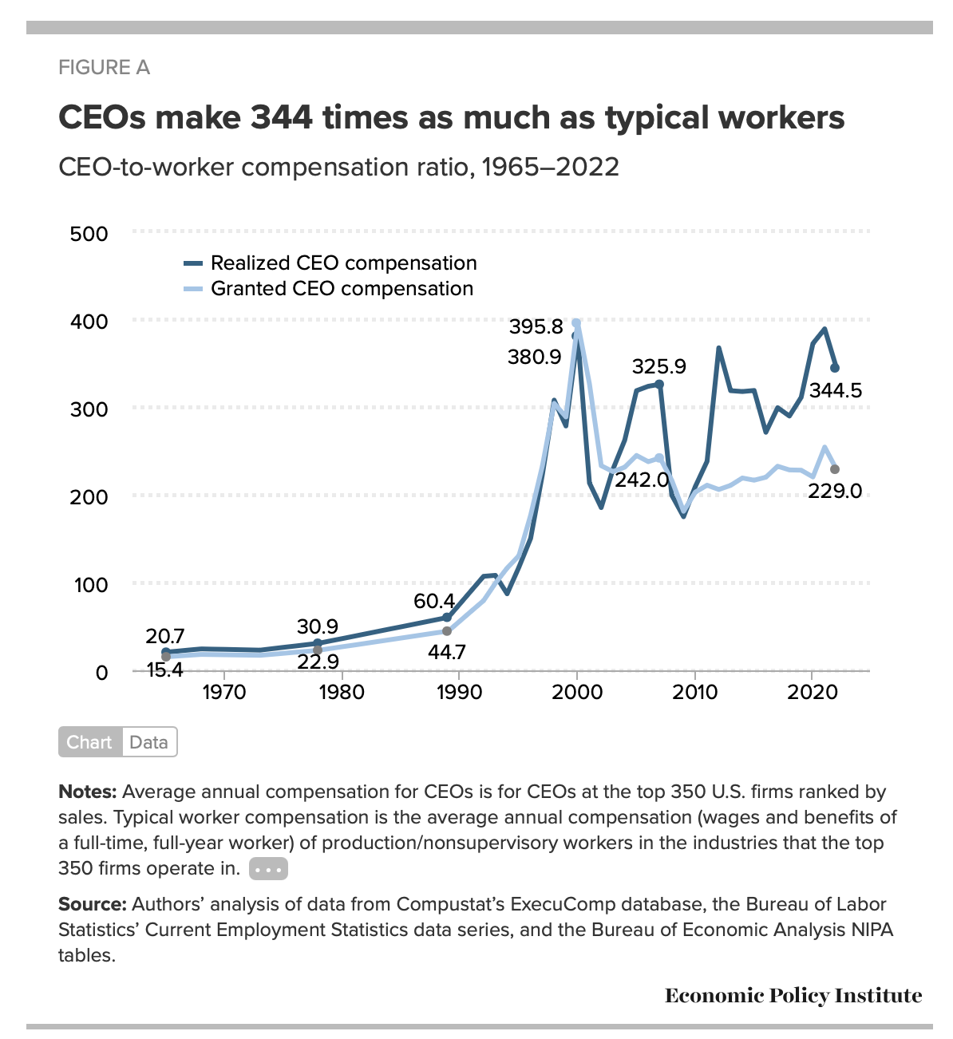
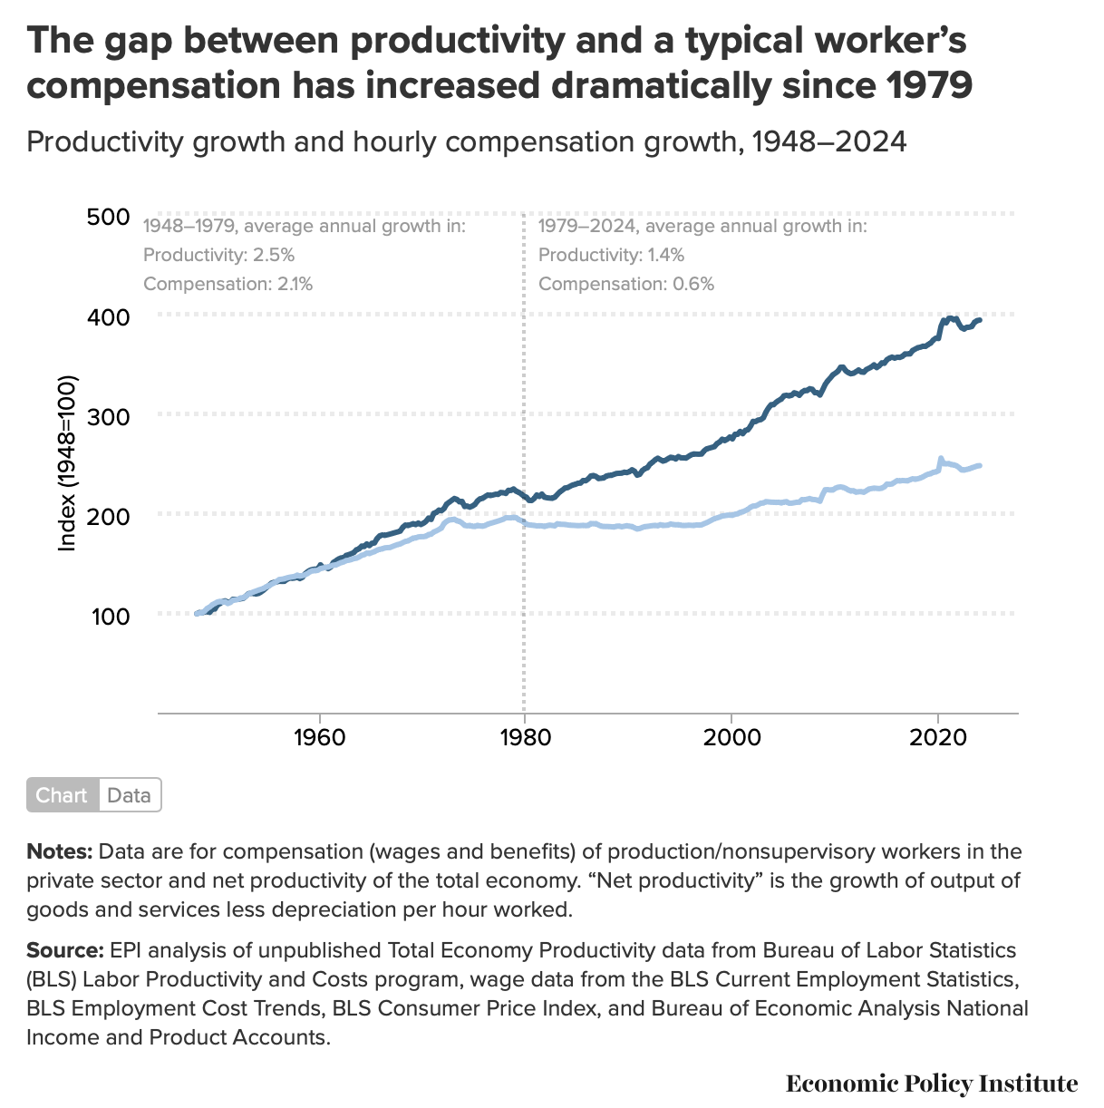
https://www.epi.org/publication/ceo-pay-in-2022/#fig-a

Slide 14
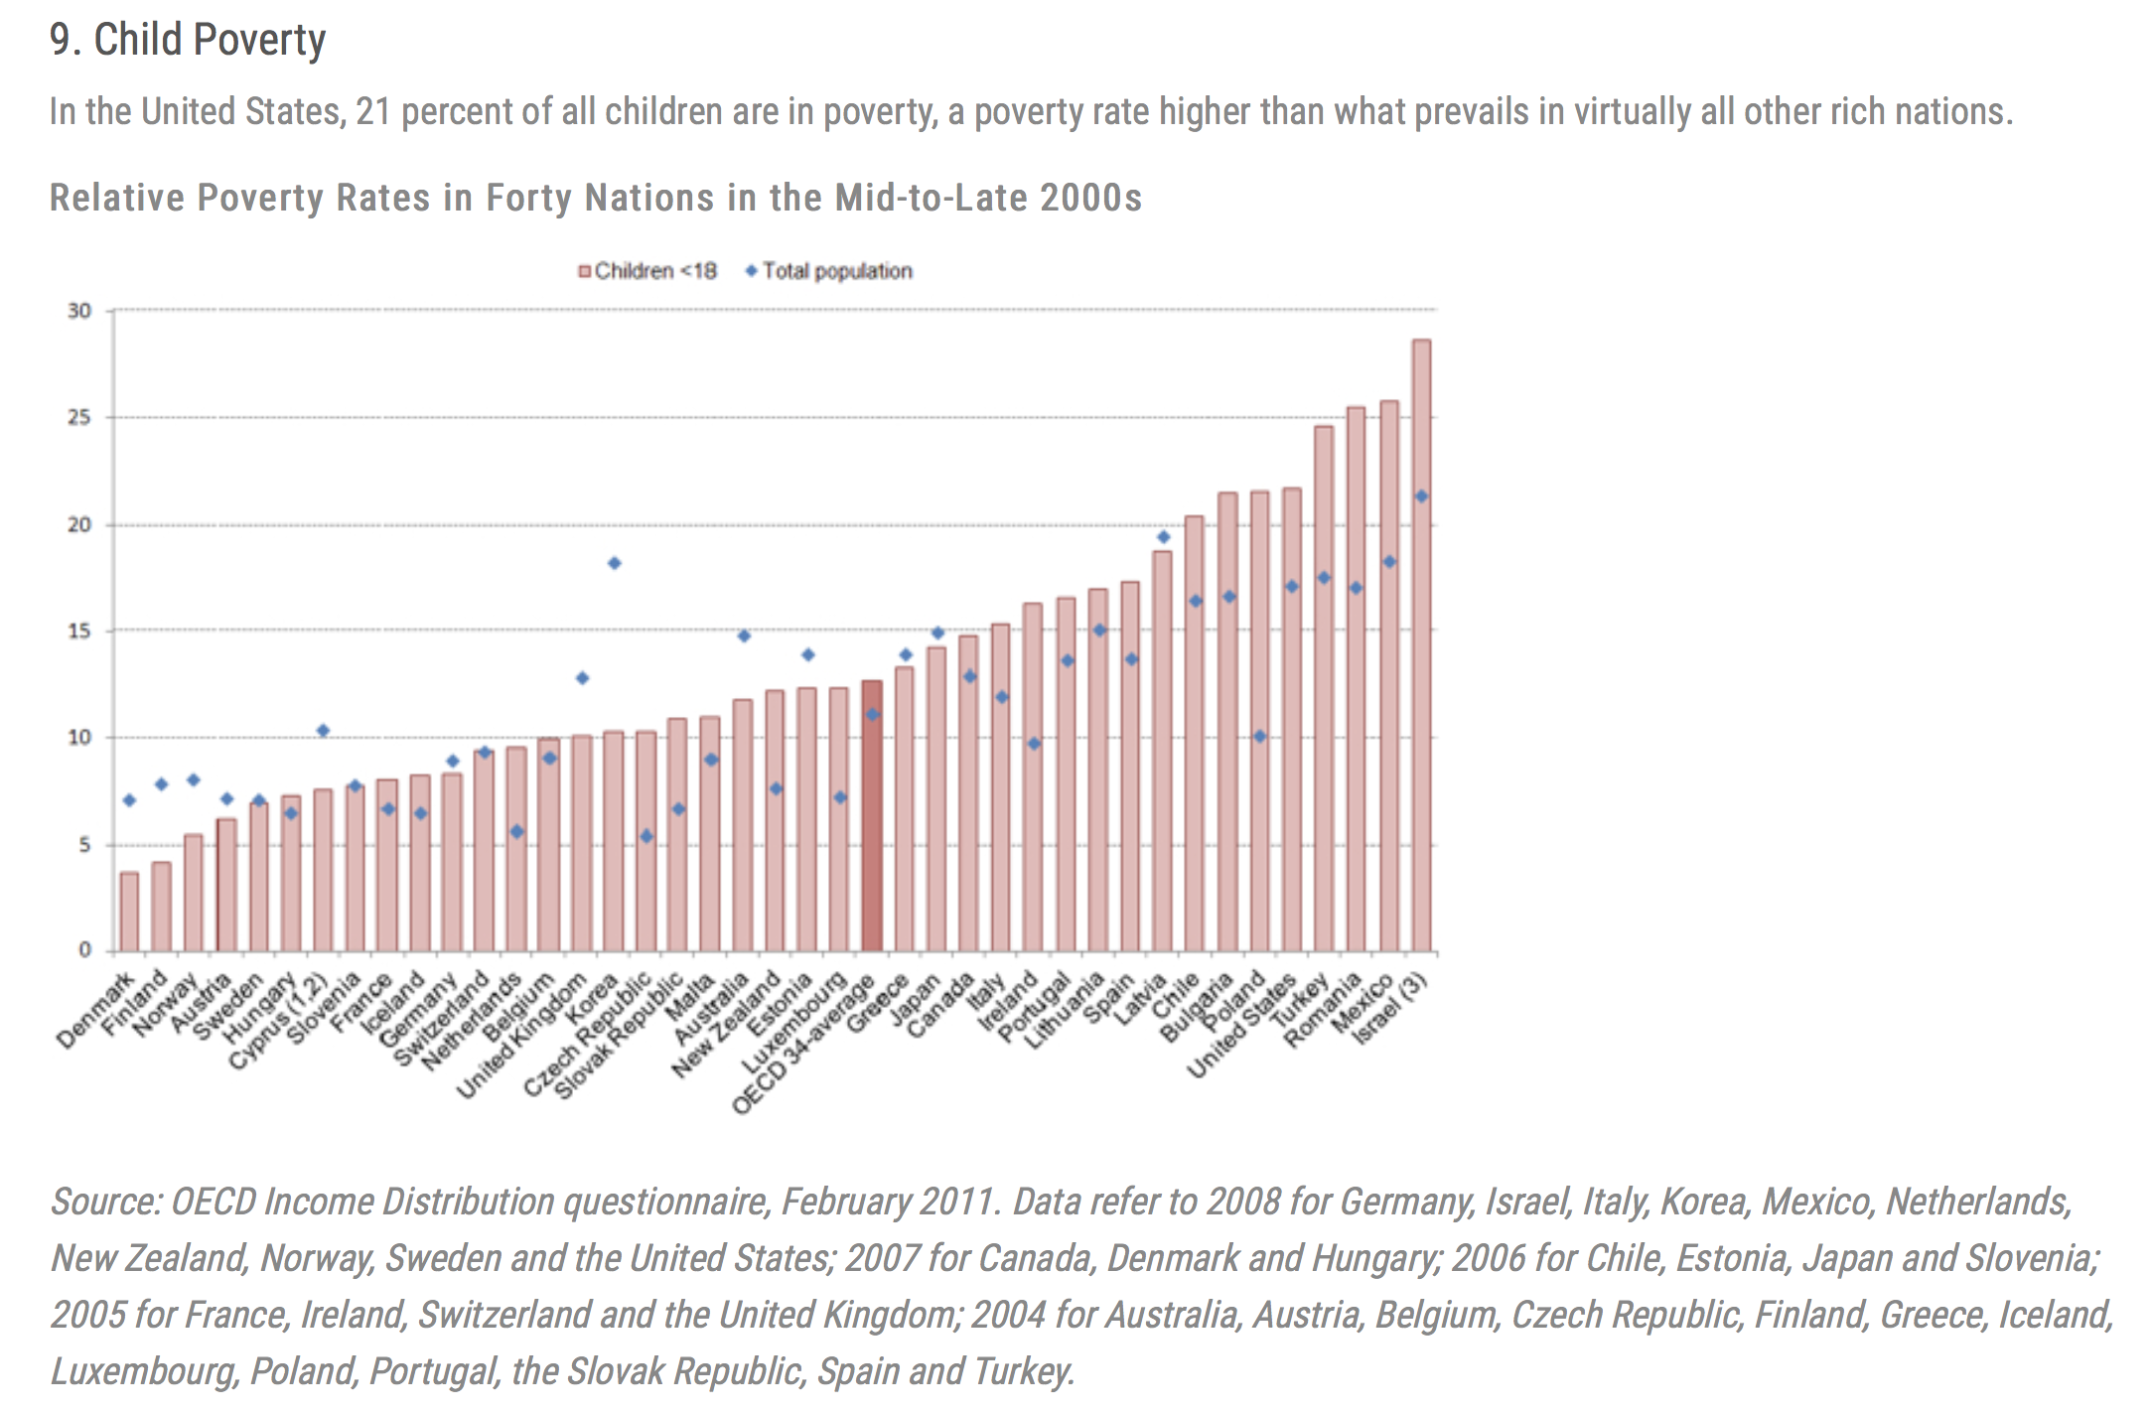
Intergenerational
from: 20 Facts About U.S. Inequality that Everyone Should Know
20 Facts About U.S. Inequality that Everyone Should Know

Slide 15
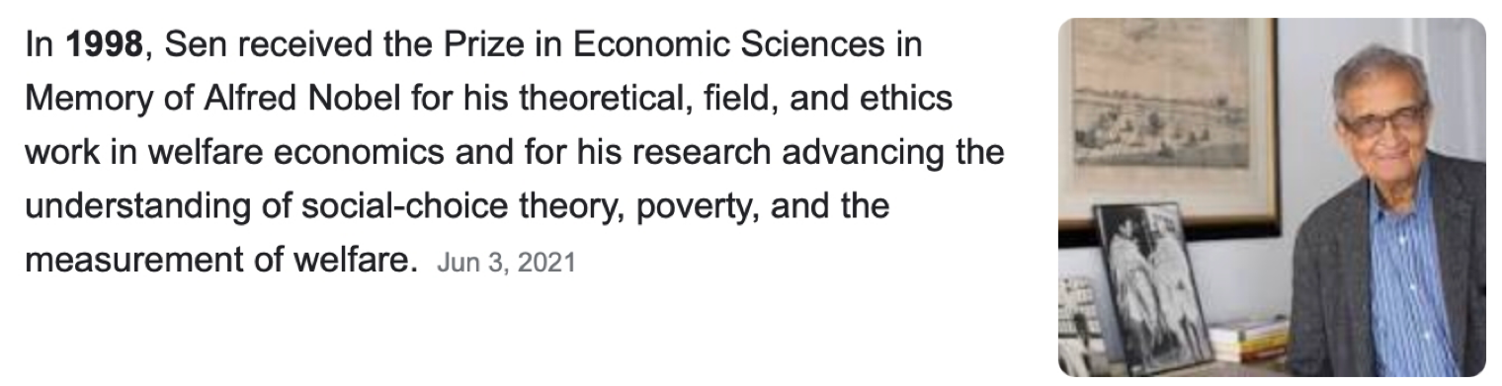
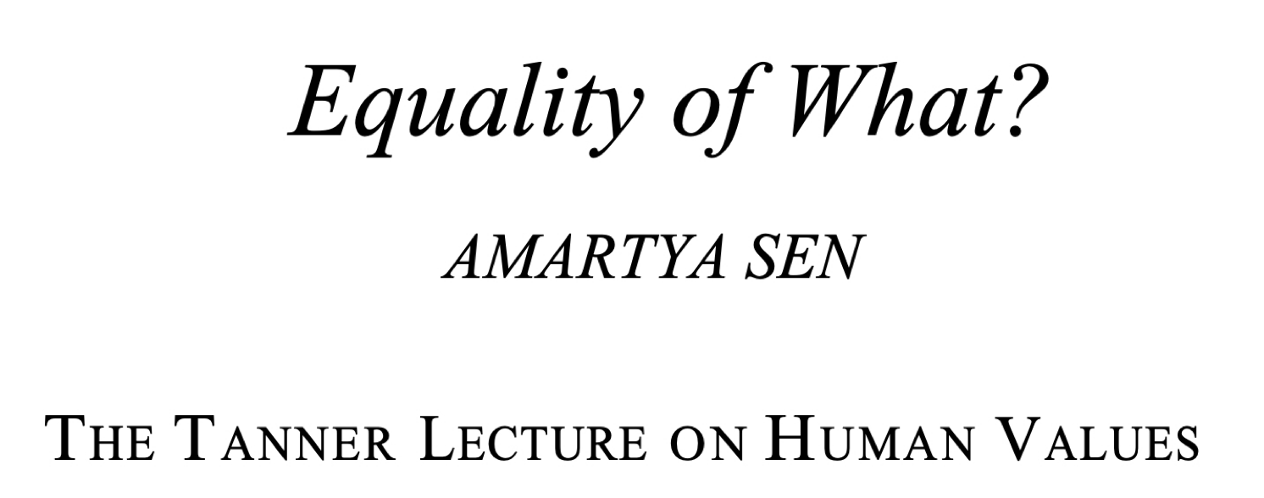
If you are interested in the general moral philosophy of inequality, I recommend:
In your reading list (optional)
https://www.ophi.org.uk/wp-content/uploads/Sen-1979_Equality-of-What.pdf
Notes:
This is more sophisticated, and speaks of inequalities of human capabilities (such as life expectancy), not just money.

Slide 16

Origins of wealth inequality
Two Different Issues:
Piketty, Bowles,…
Marx, Stieglitz, …
Transmission of wealth over time
Allocation of production returns as Income
wealth “dynamics”
income: labor vs capital
Policy solutions :
depreciation, expropriation
government: inheritance taxes
firms
government: redistribution, social services
https://harris.uchicago.edu/research-impact/centers-institutes/stone-center
Notes:
So this is a rough summary of the inequality analysis literature: wealth dynamics is created in modern societies by collectives (firms, other organizations, cities, nations, other networks). So one problem that creates inequality is who gets this produced wealth. On the other hand there is the problem that once possessed it is much easier to keep wealth - even without innovation or particular merit - and so wealth should not be transmitted to new generations over time. These are just some issues, but a systematic approach to wealth dynamics is still needed…

Slide 17

Where does this all fit with Cities?
equilibrium + scaling
statistics
growth
Notes:
Nothing of the preceding dealt with cities, though clearly inequality is most corrosive in larger cities, such as Sa Francisco, New York City, and so on. Also, and maybe especially, in developing cities in Brazil, South Africa, other African nations.

Slide 18
Economic Growth and Cities: Surplus from spatial “equilibrium”
budget:
$$Y(N)-C(N)$$
Surplus
growth
interactions
costs
transportation, housing
1. The Problem of Statistics
diversity, inequality: broad distributions of wealth
2. The Problem of Growth
cities are not static: they grow at a few percent a year!! good or bad?
Notes:
So, as advertised, let’s start analyzing wealth dynamics more carefully, and connect it to where we left urban scaling theory, in terms of benefits minus costs, experienced by each person. This sets up two interesting problems, of statistics and of growth, which are entangled in complex systems (spoiler: this is what leads to lognormal and power law distributions).

Slide 19
Recall:
Economic Growth
where do economic growth rates come from?
$$\frac{dY}{dt}=ηY$$
Exponential Growth: 2-3% a year for USA
noisy, scale dependent, variable
inequality
Notes:
The reference here is that the growth of aggregate income (GDP) in a modern nation is a about 2-3% a year. Fast urbanizing and developing nations can grow faster, but typically also with larger fluctuations. A 1%/year exponential growth rate translates in its doubling in about 72 years (this is known as the ‘rule of 72’), so 3% is about 24 years, or a generation.

Slide 20
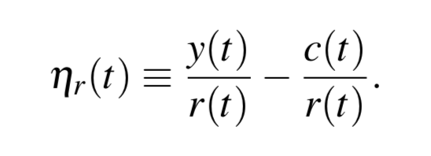
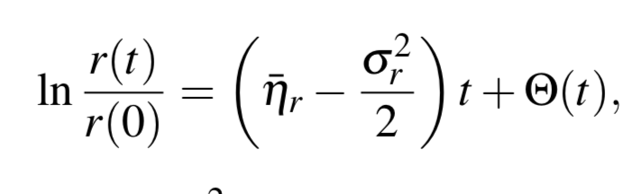
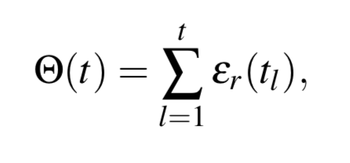
Α Simple Model of Resource Dynamics
flows: income
costs
$$\frac{dr(t)}{dt}=y(t)-c(t)=η_{r}(t)r(t)$$
“one-good wealth accumulation model”
in economics
change in resources
savings rate = growth rate
stock: wealth, energy
growth
“spatial equilibrium”
Solution:
definition
noise:
Normal “bell curve”
because of the central limit theorem
Notes:
The simplest model we can write is one in which resources (or wealth) grows as the difference of income minus costs, but where this process defines a growth rate as shown. This model is very general (almost inevitable), but the interesting part is in the parameters, here the growth rate which is treated as a stochastic (fluctuating) quantity with a temporal mean and a variance. Stochastic calculus (Ito) allows us to integrate these dynamics when these are time independent to get the solution in the bottom line.

Slide 21

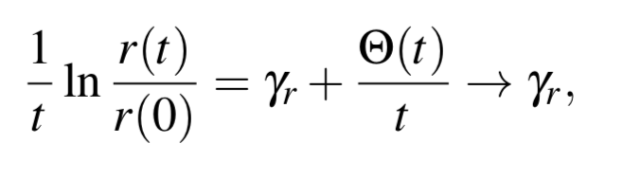
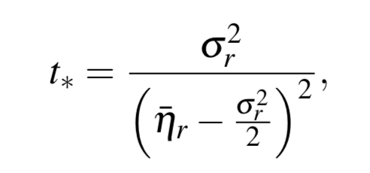
The counter intuitive consequences of stochastic geometric growth
Consequences:
zero average, standard deviation:
$$σ_{Θ}=σ_{r}\sqrt{t}$$
1.
$$∼σ_{r}\sqrt{t}$$
Central Limit Theorem -> Gaussian
lognormal statistics !!
2.
The average growth rate over long times
becomes a simple number
ergodicity
3.
There is a minimum time to see through the
“fog” of sort term fluctuations.
proportional to the uncertainty (volatility, std) between relative income and costs
people with a lot if uncertainty do not see growth as a possibility
Notes:
This simple equation has a number of important consequences: wealth is distributed as a lognormal (as we expected), the long term dynamics when the growth rate is positive becomes deterministic. But this characteristic time between deterministic and fluctuations dominated dynamics depends on the ratio of the volatility squared (variance) and the square of the men growth. People/organizations with large fluctuations do not perceive the growth regime, an dmay not be able to plan it.

Slide 22
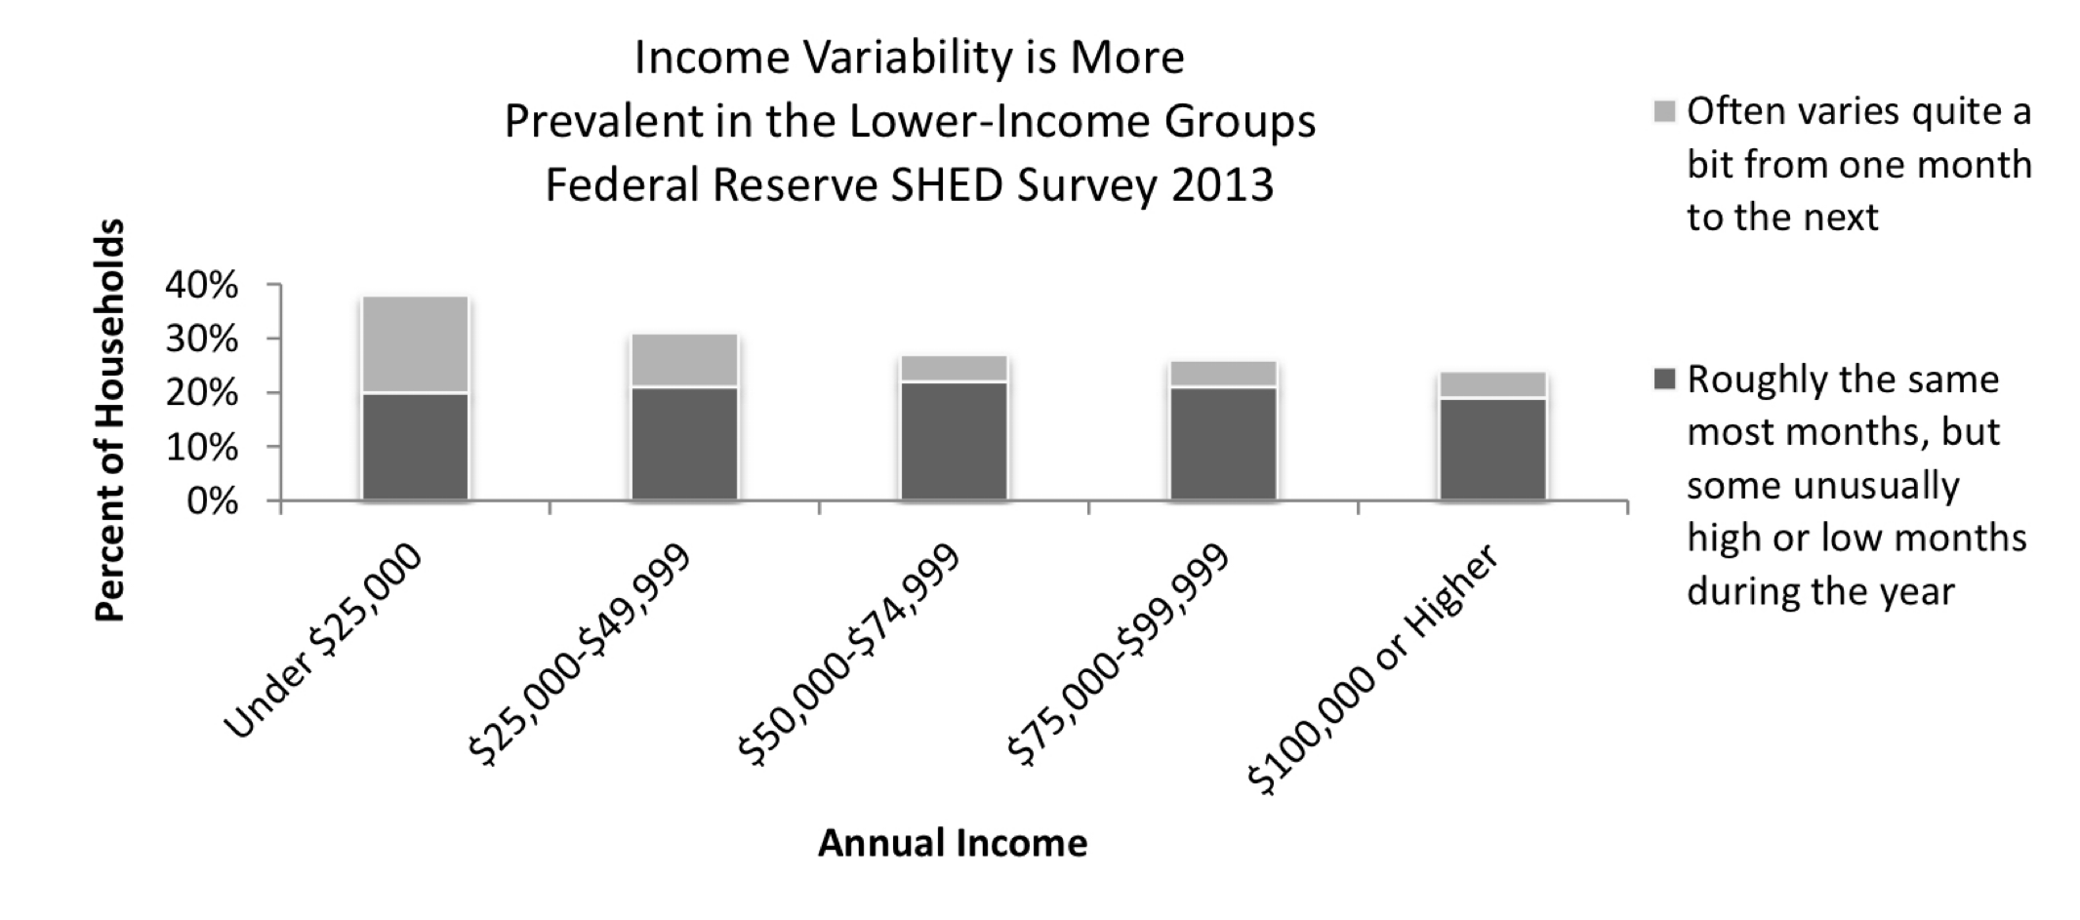
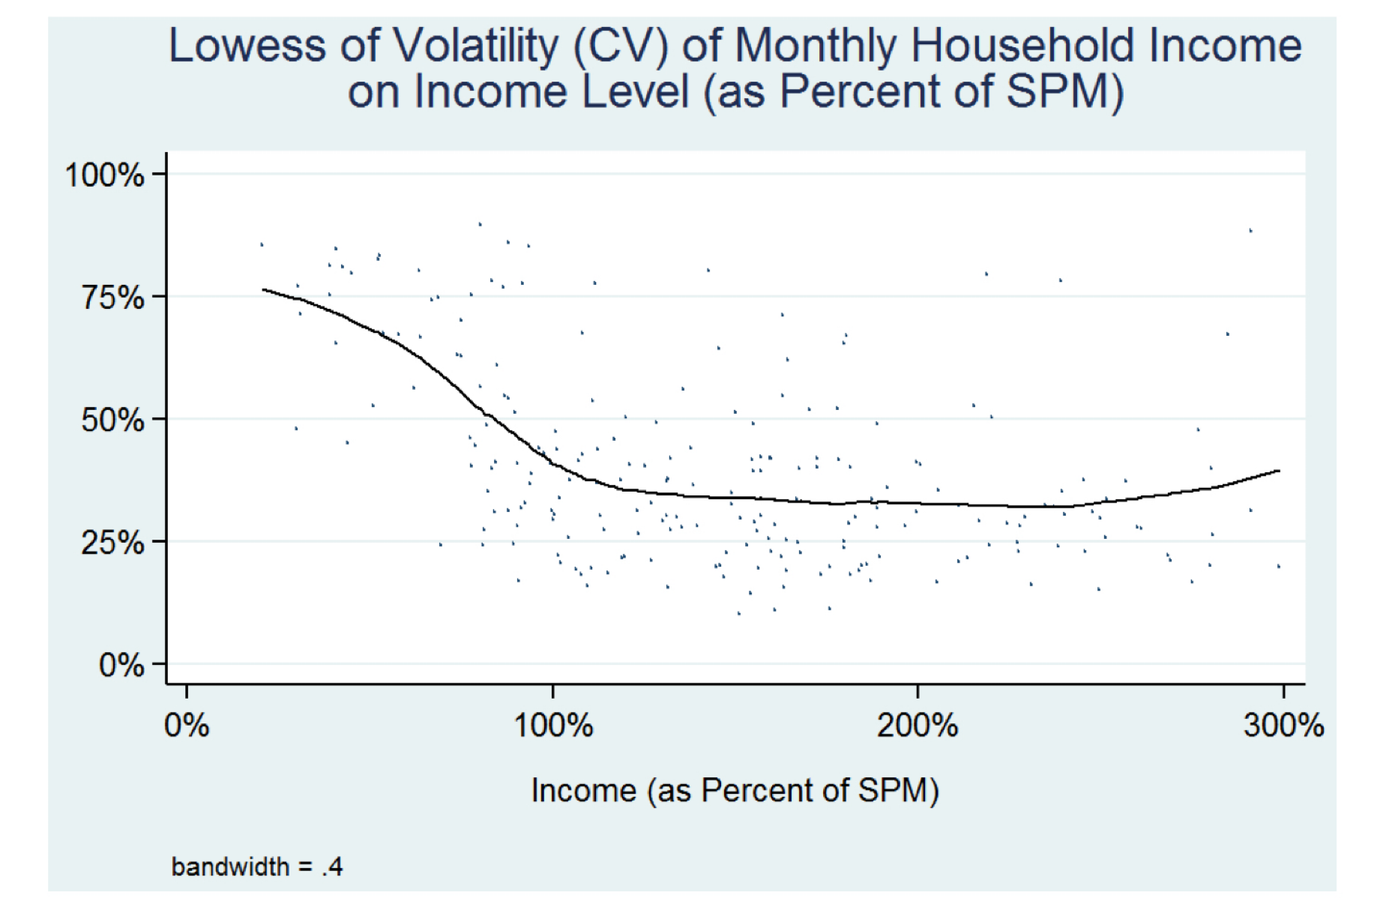
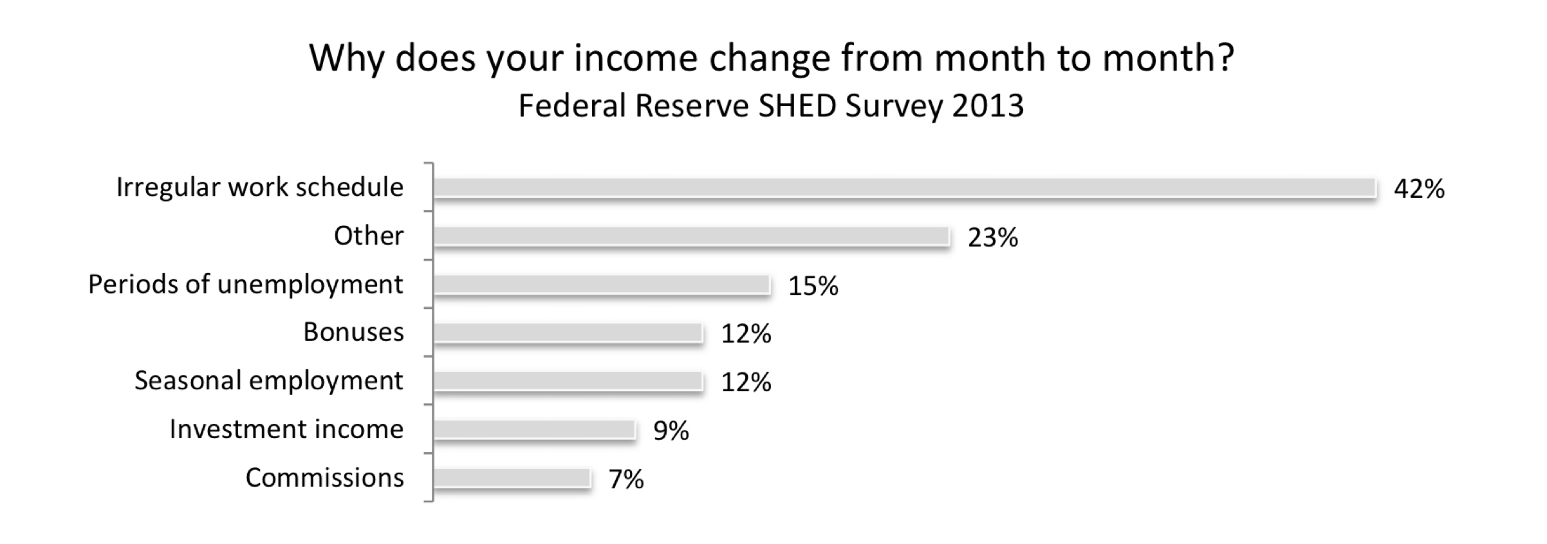
The working poor experience much more volatility
lower effective growth rates, unclear horizons
from: Income Gains and Month-to-Month Income Volatility: Household evidence from the US Financial Diaries¹ Hannagan + Morduch (2015)
Notes:
This is a tangent, but it is typical that people with lower incomes experience greater fluctuations… these results are flow financial diaries, detailed temporal records of income and expenditures.

Slide 23
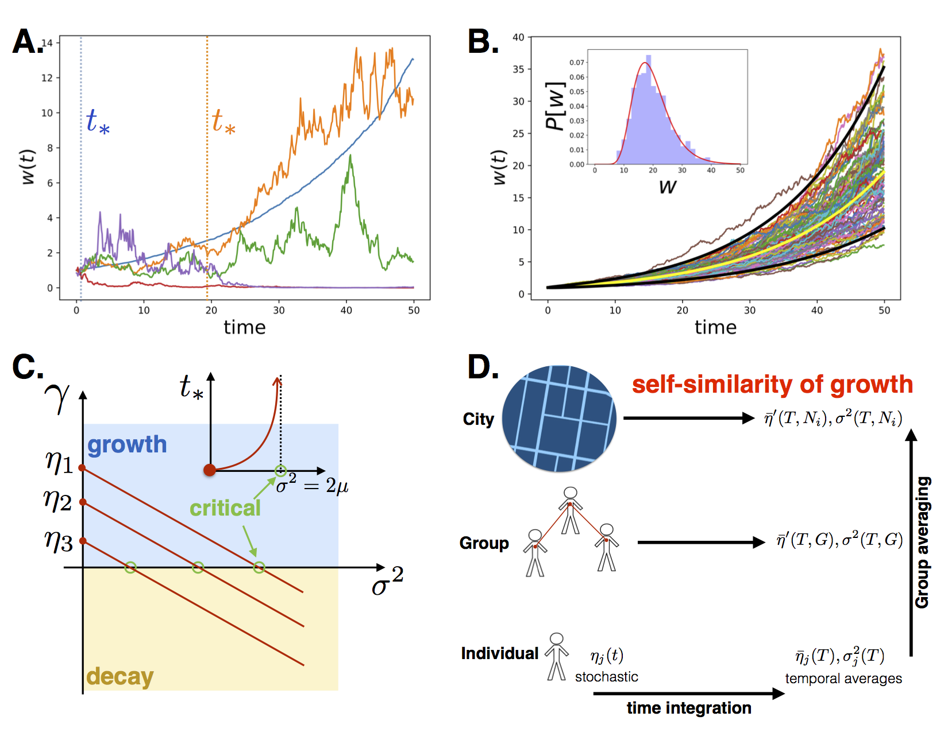
Model Solutions look like this
Model
r(t)
Notes:
Here are some trajectories out of solving the model numerically. The blue and orange trajectories have growth rates >0, green is zero and red and purple below zero. Not that these are hard to distinguish in the shoe term, but the difference s obvious at longer times.

Slide 24
Log normal statistics
r(t)
Notes:
And here are a set of trajectories with the same average and volatility, showing the emergence of the lognormal.

Slide 25
Net Growth Requires Low Fluctuations
$$γ=η-\frac{σ^{2}}{2}$$
effective growth rate
Notes:
These results also mean that for any positive growth rate, growth can be destroyed (and eventually reversed) by larger and larger fluctuations leading to a sort of critical point when t_* goes to infinity.

Slide 26


Want low fluctuations:
$$=b(t)-a(t)=\overline{η}+u(t)-v(t)=\overline{η}+ϵ(t)$$
definition
income
fluctuations
definition
choice
expenditures
when I have more money can spend more and vice-versa
Consumption Smoothing
need to average (smoothen) expenditures and incomes over some time
month, season, year
feedback control theory
Notes:
So for growth to persist, we need not only a positive average growth rate but also low fluctuations. We will later compute the growth rate, but in this module will now discuss how fluctuations can be tamed. This is an example of feedback control, where the fluctuations in income minus costs are the object of control.

Slide 27

Feedback Control is a big part of your life
Notes:
This idea is fundamental in engineered systems, feedback control is one of the theories of complex systems as well, responsive for dynamical homeostasis, for example in your body.

Slide 28



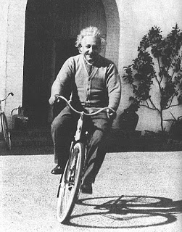
Feedback Control is a big part of your life
Notes:
And is not an exotic idea, but in fact the way all of modern engineering (and much of biology) do the difficult things they do, presenting stable systems to users. So, for example, many air planes need to be automatically stabilized, so that they can be controlled, computer chips make errors but these are automatically corrected, self-driving cars are mostly based on controls of distances to other cars and road references (lines, barriers) and people an robots achieve balance dynamically.

Slide 29
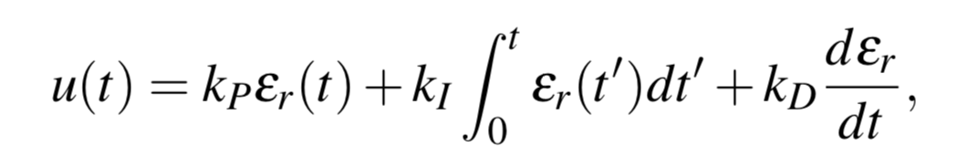
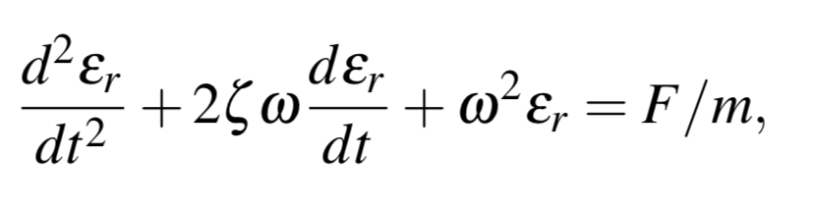
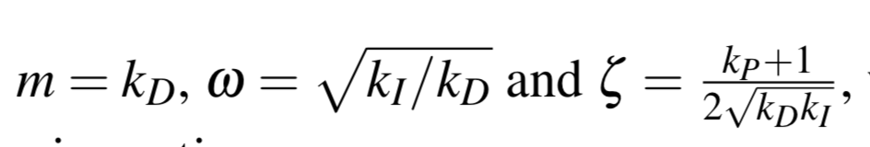
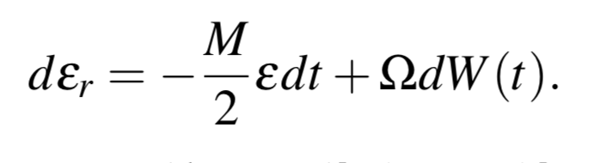
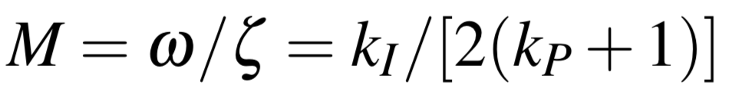
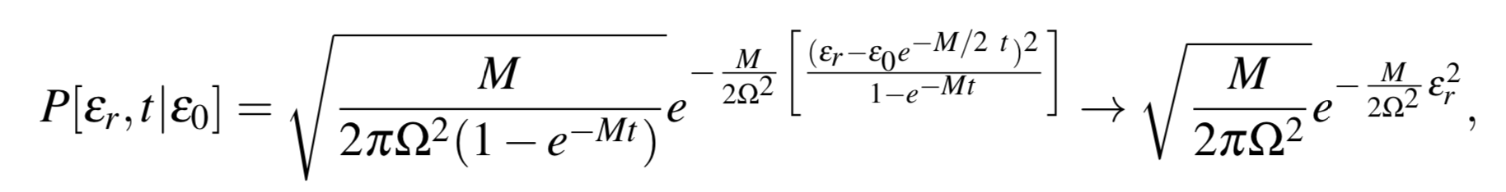

How Control theory works:
PID Controller
Time costs to track income fluctuations
This gives a simple dynamics for errors
noisy spring
error wants to vanish
noise
Statistics of error is “under control”:
Notes:
There are many forms of achieving control, but the basics are to identify a variable that tracks the deviation between the desired state and what is observed, here \epsilon. We then build a control variable, u (here deviation from some mean income minus costs), as a function of \epsilon. The simplest is proportional to epsilon, to its time integral, and its derivative (PID controller). This leads to a damped oscillating dynamics, where \Sigma^2/M is the variance of remaining fluctuations, which can be made as small as wanted if savings are averaged over longer periods.

Slide 30
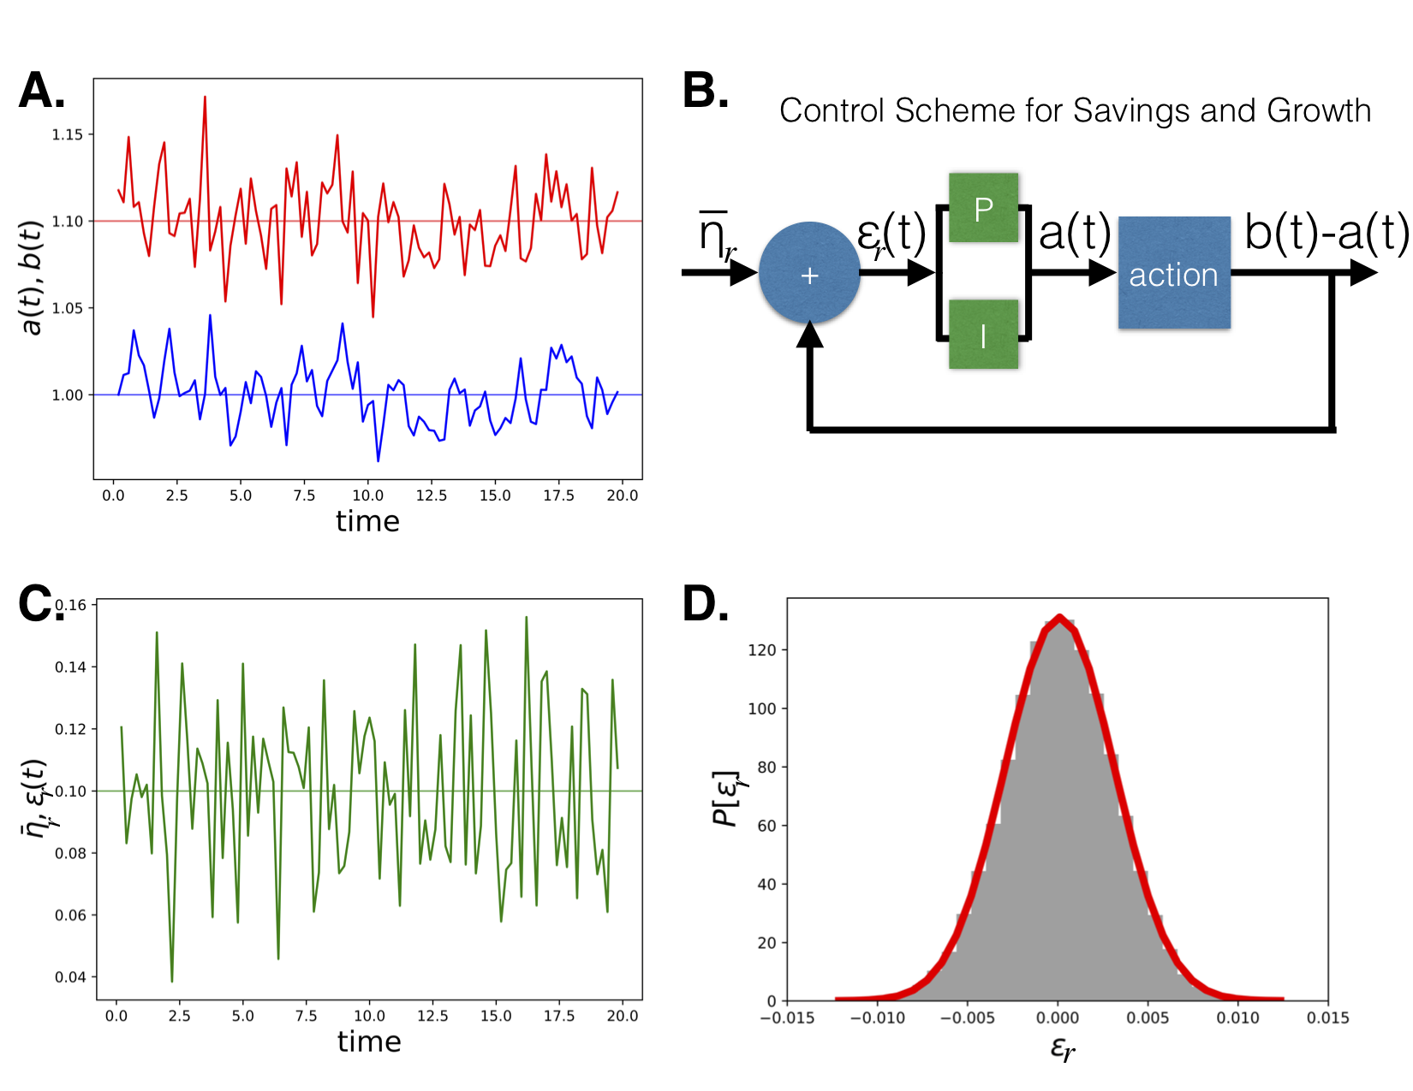
“Consumption Smoothing”
Notes:
This leads to small fluctuations, that are Gaussian distributed, which also mean that costs and incomes become mutually dependent variables, defining a sensible stochastic growth rate. In the absence of this type of control the growth rate and fluctuations could have been anything, and the resource statistics would not have been necessarily lognormal.
Finally note that consumption smoothing can be achieved at many different scales, from households to groups of people, to nations.

Slide 31
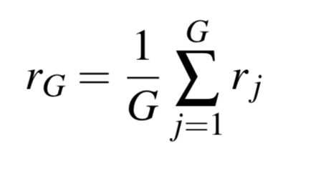
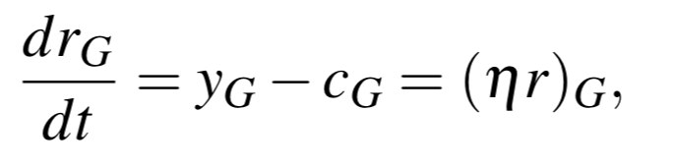
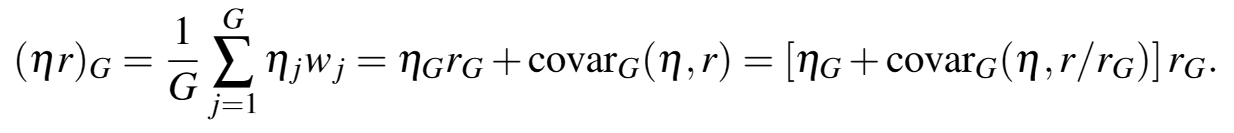
Growth rates for individuals and for cities
Is the growth rate for a city the average of the growth rates for individuals?
Not in general:
average resources
growth of resources per capita in a population
average of product
average rate
“selection”
Notes:
Finally, we note a few more consequences of exponential, stochastic growth at the population level: First, its average in a population is not just the average growth but pick us a covariance between the relative magnitude of wealth and of growth rates:

Slide 32
Consequences:
positive: richer people get higher growth rates
correlation between resources and rates
negative: richer people get lower growth rates
anti-correlation between resources and rates
What situation gives the highest overall growth rates?
What situation gives the lowest inequality?
Notes:
This means that - everything else being equal - population level growth (nation, city) will be largest when the covariance is maximized, and the rich experience larger growth rates. (This is because that is where the money is. However, this will create terrible inequality. This appears to be the mode of growth that the US has been on for a few decades. Note that providing better returns to poorer people instead of the richest would actually reduce the growth rate. The solution is that better conditions for poorer population must also increase the average growth rate, e.g. via education and knowledge relevant to entrepreneurship, as we will show later.

Slide 33
Corrections to scaling exponents
$$Y(N)=Y_{0}N^{β}e^{ξ}→⟨Y(N)⟩=Y_{0}N^{β}⟨e^{ξ}⟩$$
lognormal
$$e^{\frac{σ^{2}(N)}{2}}$$
varies with N
scaling exponents become scale dependent
loss of scale invariance
requires a theory for the variances
more complicated statistics
Notes:
The second effect is that if the fluctuations are population size dependent, they will result in corrections to the observed scaling exponents. This is analogous to the running of parameters with scale in statistical physics (renormalization group), but is here applied to exponential growth and the scale is population size.

Slide 34
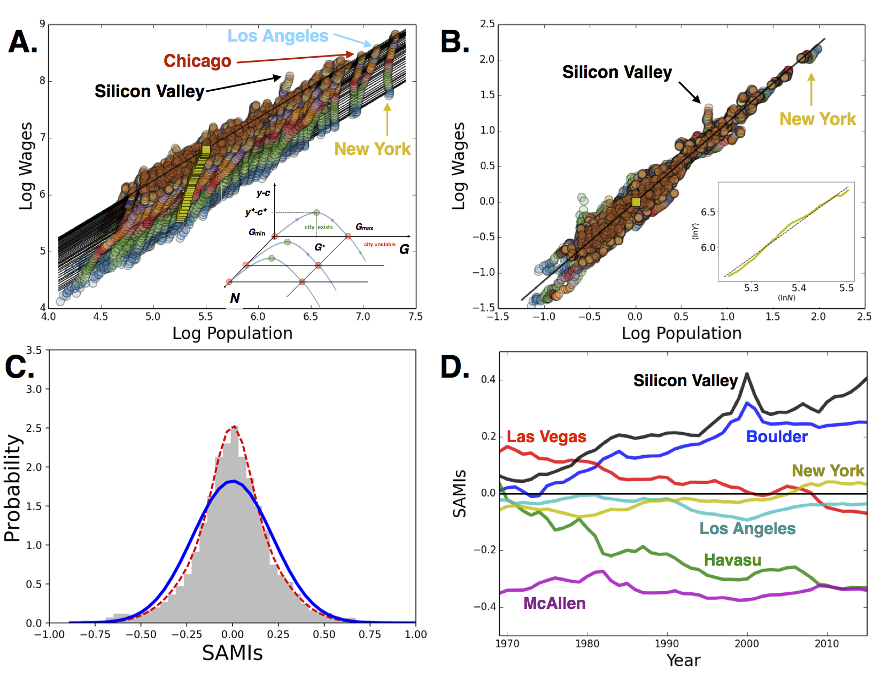

σ
Notes:
OK, with all this in hand we can return to this picture and understand it. Fluctuations in wages are approximately lognormal (but pick as small correction because wages are in income, not a resource, panel C), fluctuations change very slowly as observed…

Slide 35
How Long does it take Cities to Catch Up with Others?
In the US, very small randomness
The typical square displacement of
$$ξ^{2}(t)=σ^{2}t≃0.054$$
in 50 years !!
Observe:
$$⟨ξ^{2}(1969)⟩=0.043$$
could have been ~ 0
40 years before: in the 1920s
How long does it take to create an equitable society?
About a Generation ~ 20-50 years
slower with slow economic and demographic growth rates
Notes:
From the observed growth rates we can estimate that the typical timescale for the SAMIs to change is indeed decades, is the relative structure of an urban system is very slow to change and the time scale is generations.

Slide 36
How about human development?

Slide 37
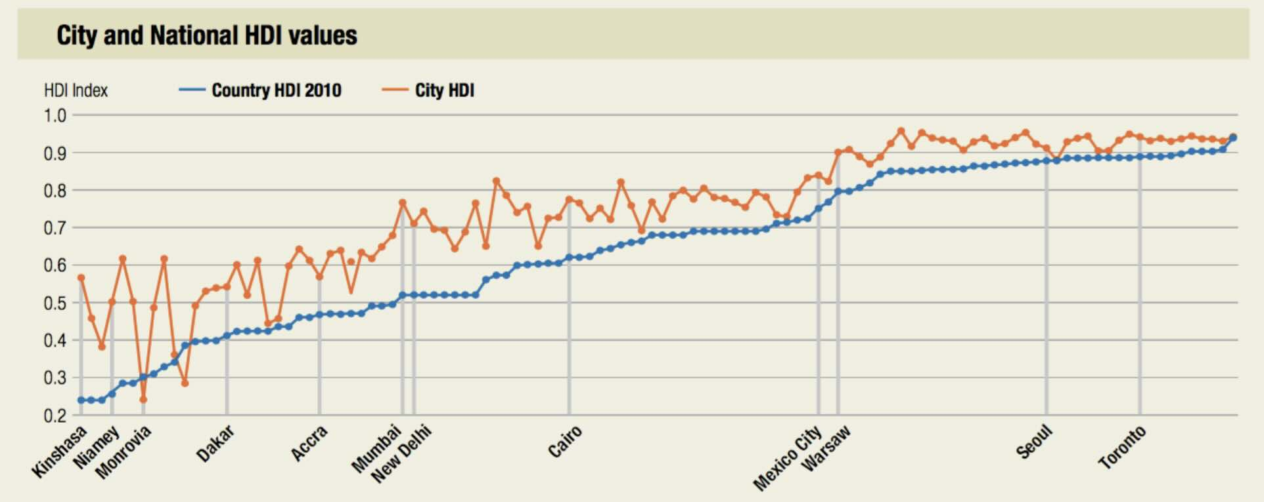
Broad Human Development is a Feature of Larger Cities !
Country and City Human Development Index (HDI) values
HDI value
Country HDI 2010
City HDI
credit: UNDP Human Development Report 2013

Slide 38


A theory of justice
Problem: how to find a socially just distribution of goods in a society?
Thought experiment:
What society would you want if you were to be swapped at random with any other person?
Original Position:
https://en.wikipedia.org/wiki/A_Theory_of_Justice
“Veil of ignorance”
about outcome
“Preference symmetry invariance”
Each citizen is guaranteed a fully adequate scheme of basic liberties, compatible with the same liberties for all
2. Social and economic inequalities are:
- to the greatest benefit of the least advantaged,
- attached to offices and positions open to all under conditions of fair equality of opportunity

Slide 39




But can people “pursue their happiness”? That takes more than goods and liberties
https://www.ophi.org.uk/wp-content/uploads/Sen-1979_Equality-of-What.pdf
“capabilities approach”:
basic capabilities
agency
empowerment
in context
processual equalities
not just money, goods, freedom,…
+ Martha Nussbaum
https://ir.lawnet.fordham.edu/cgi/viewcontent.cgi?article=3391&context=flr

Slide 40

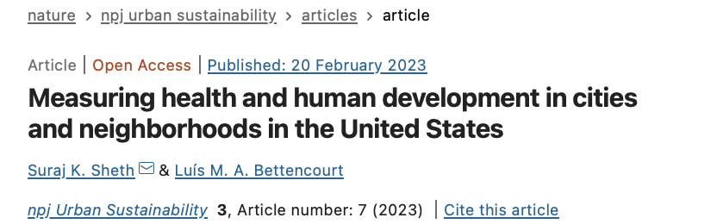
Human development as a network process (in cities)
Measuring Human Development across scales
Suraj Sheth
https://www.nature.com/articles/s42949-023-00088-y

Slide 41
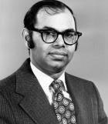
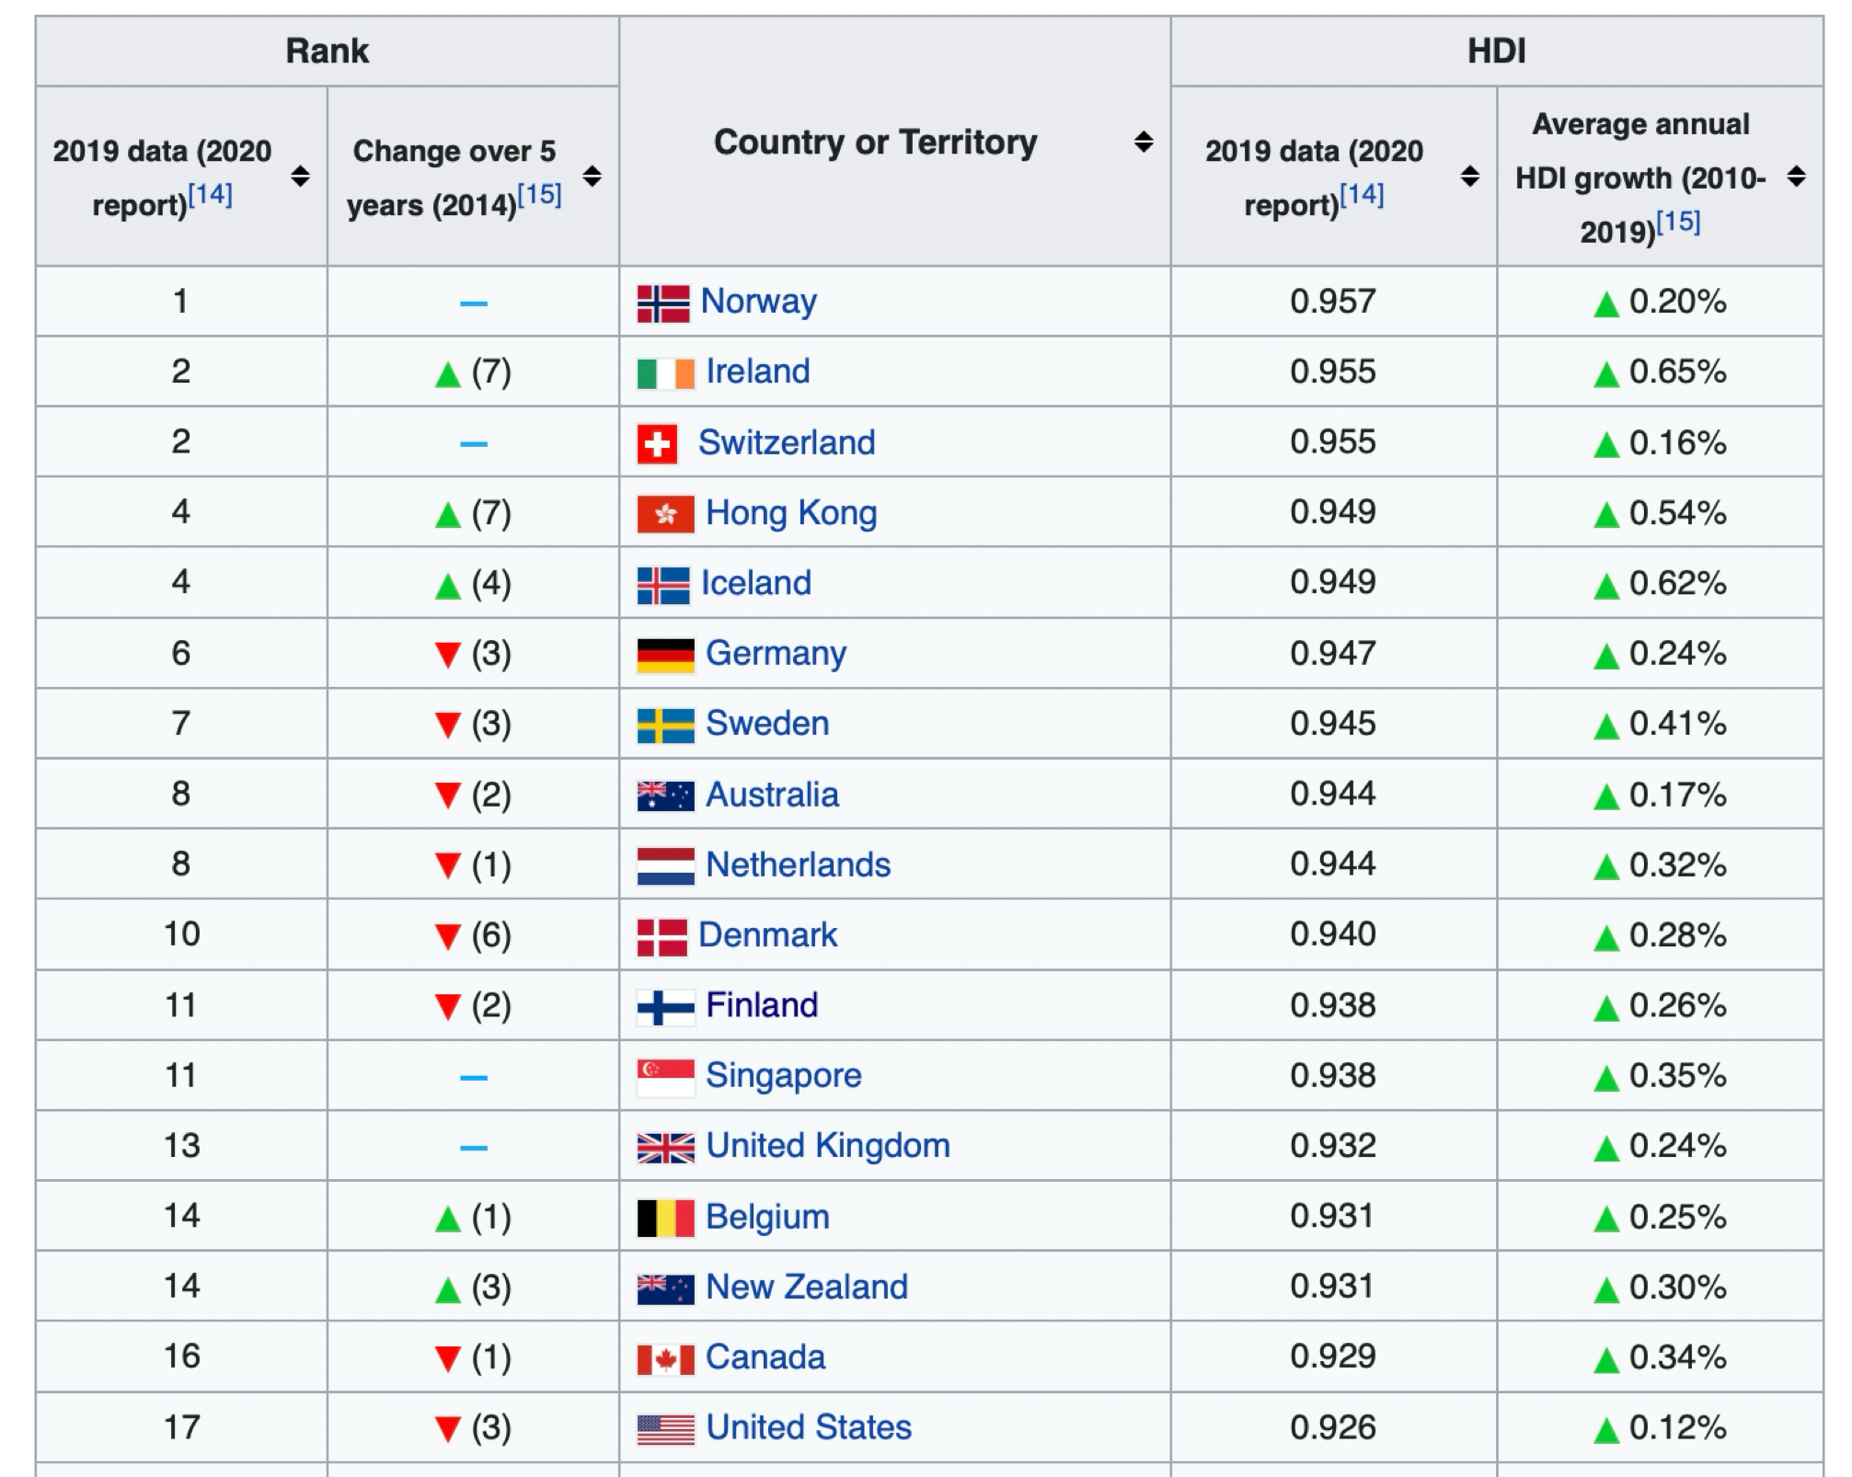
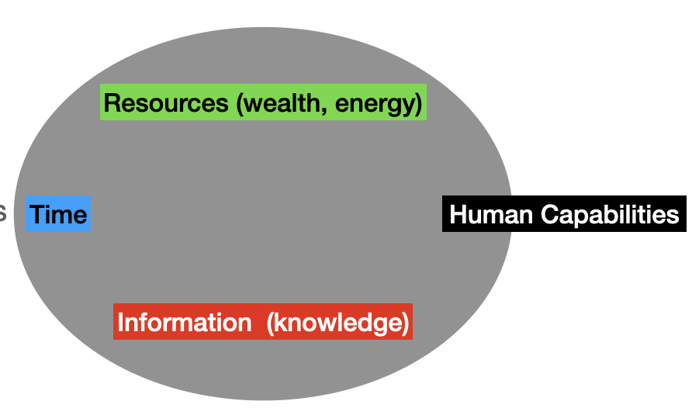
Human Development Index
“measures the ability of human populations to lead long, healthy and fulfilled lives”
Mahbub ul Haq
$${HDI}_{i}={\left({education}_{i}.{lifeexpectancy}_{i}.{realincome}_{i}\right)}^{1/3}$$
The US is now # 17
because of health and educational inequality

Slide 42
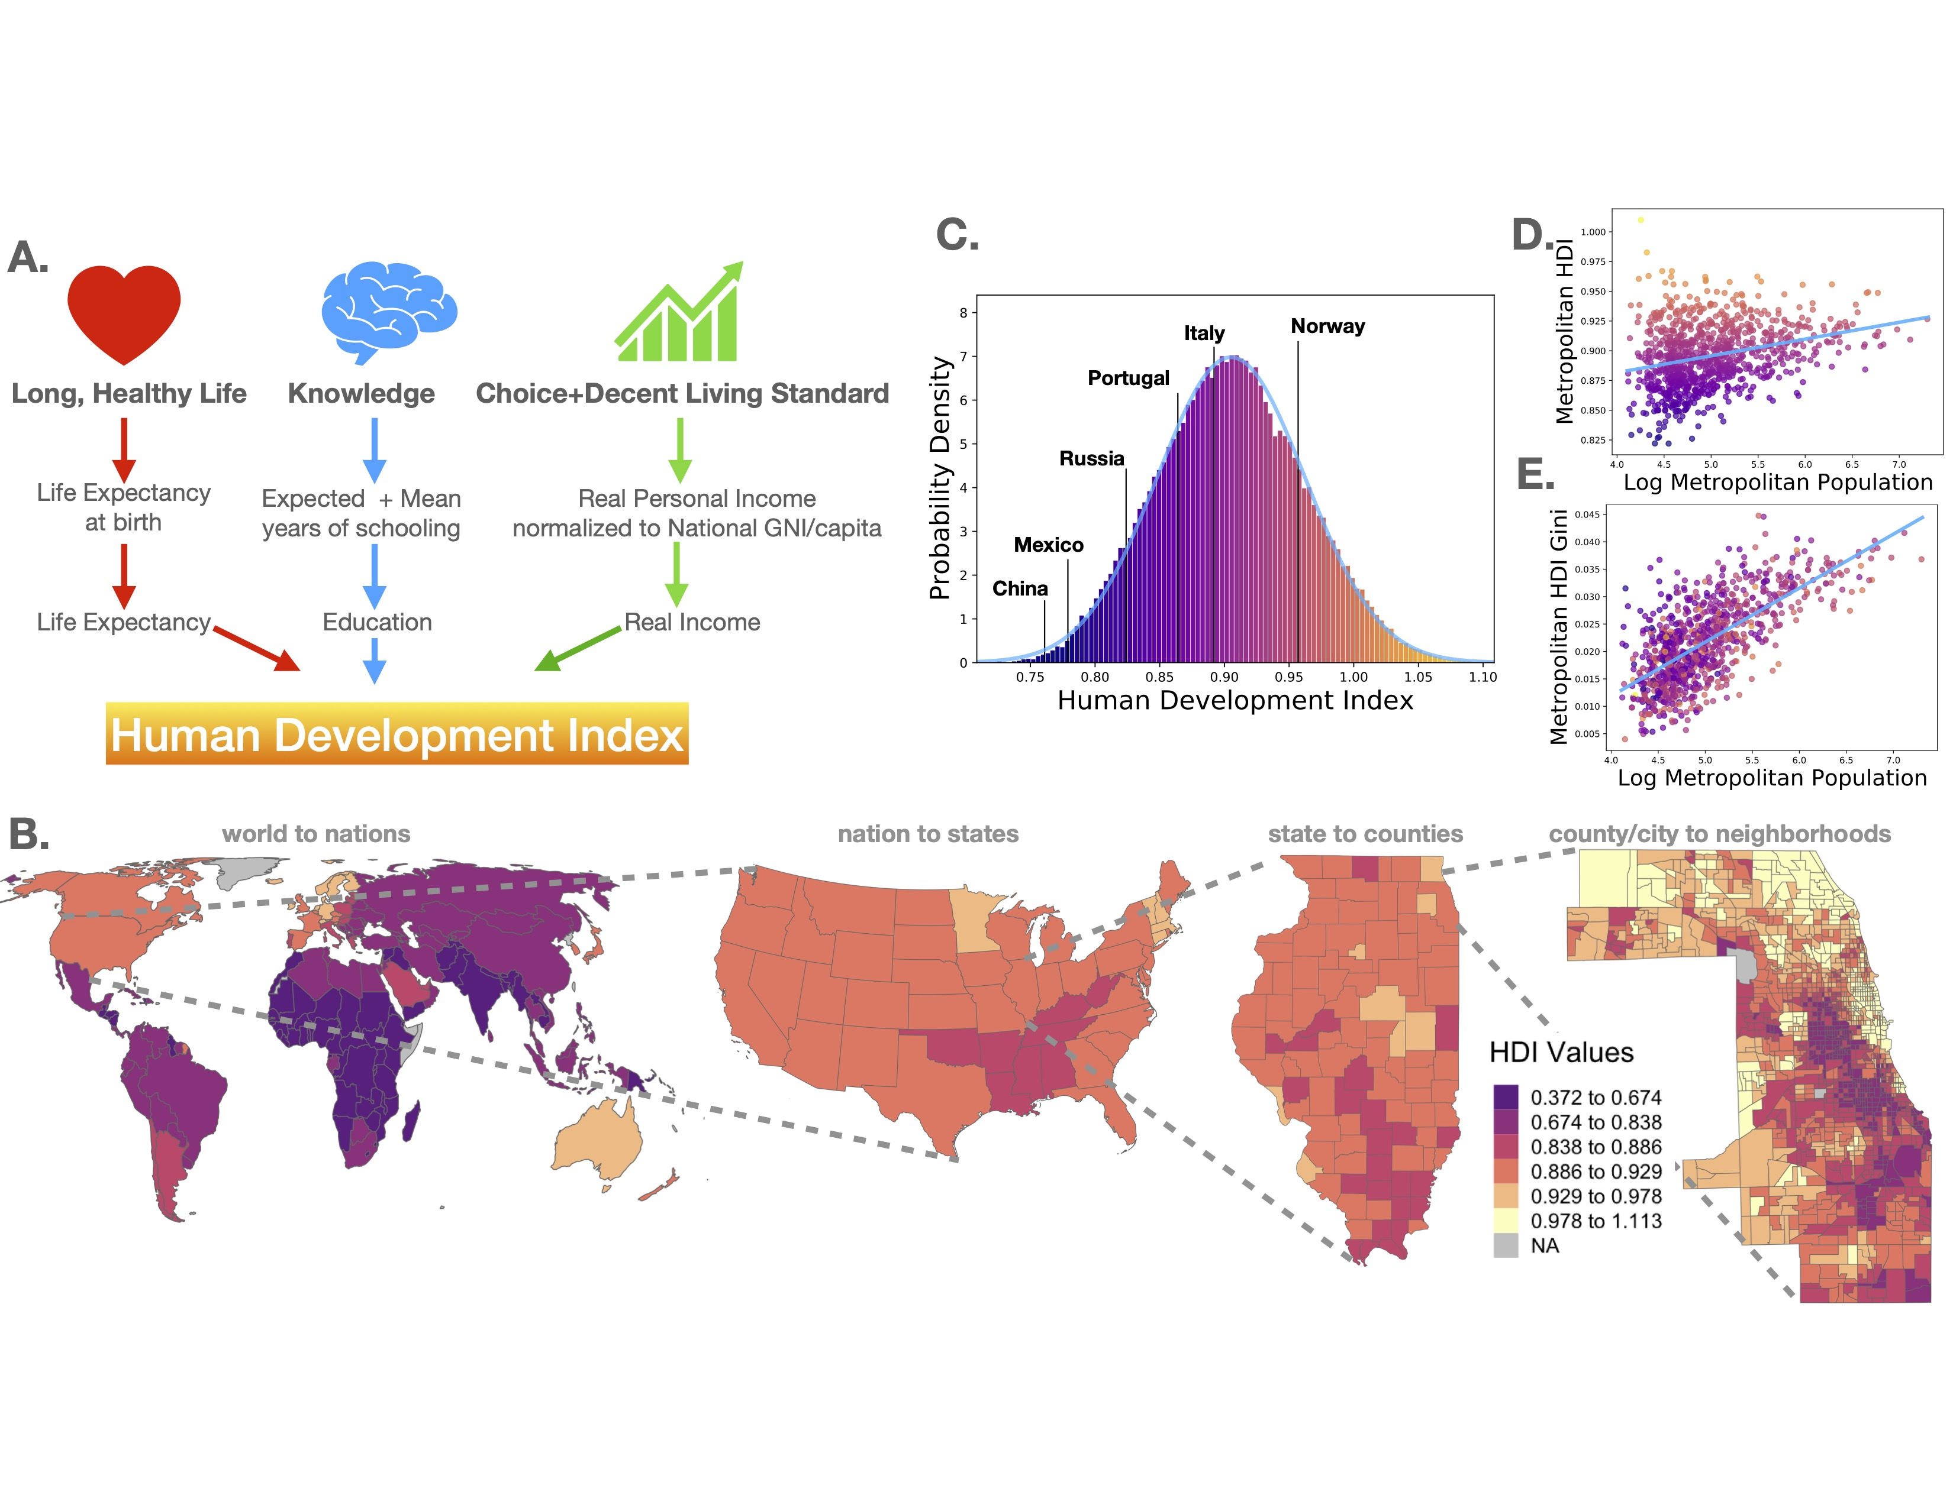
HDI increases with city size
inequality increases with city size faster
https://papers.ssrn.com/sol3/papers.cfm?abstract_id=3961750
Check out the interactive map at:
https://communityhdi.org/

Slide 43
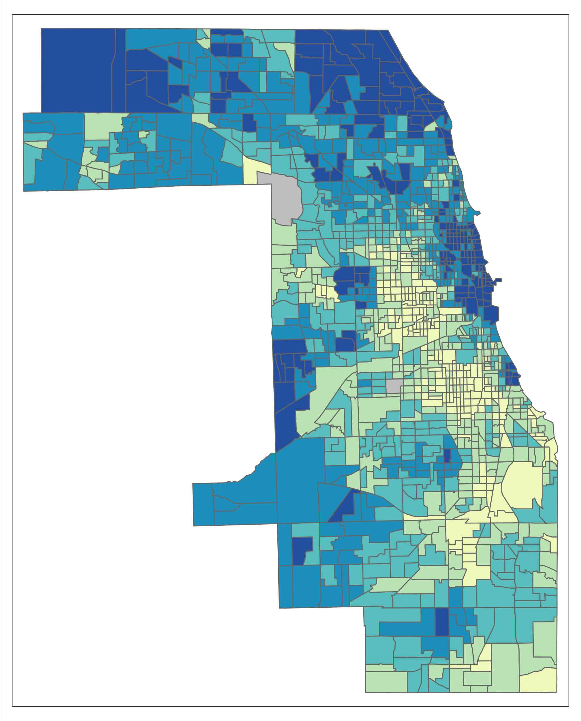
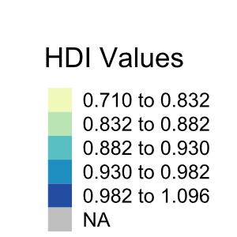
Measuring the Human Development of Chicago neighborhoods
better than Norway
worse than China or Mexico
credit: Neil Sheth (UChicago)
https://www.nature.com/articles/s42949-023-00088-y

Slide 44
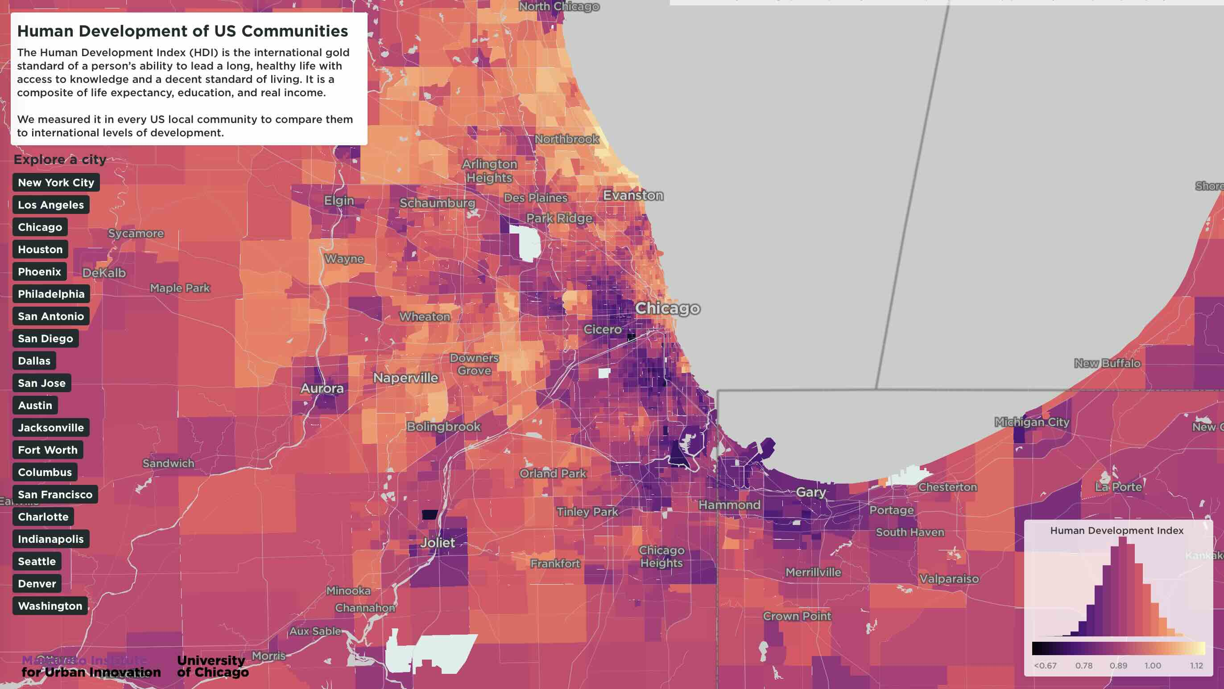

Slide 45
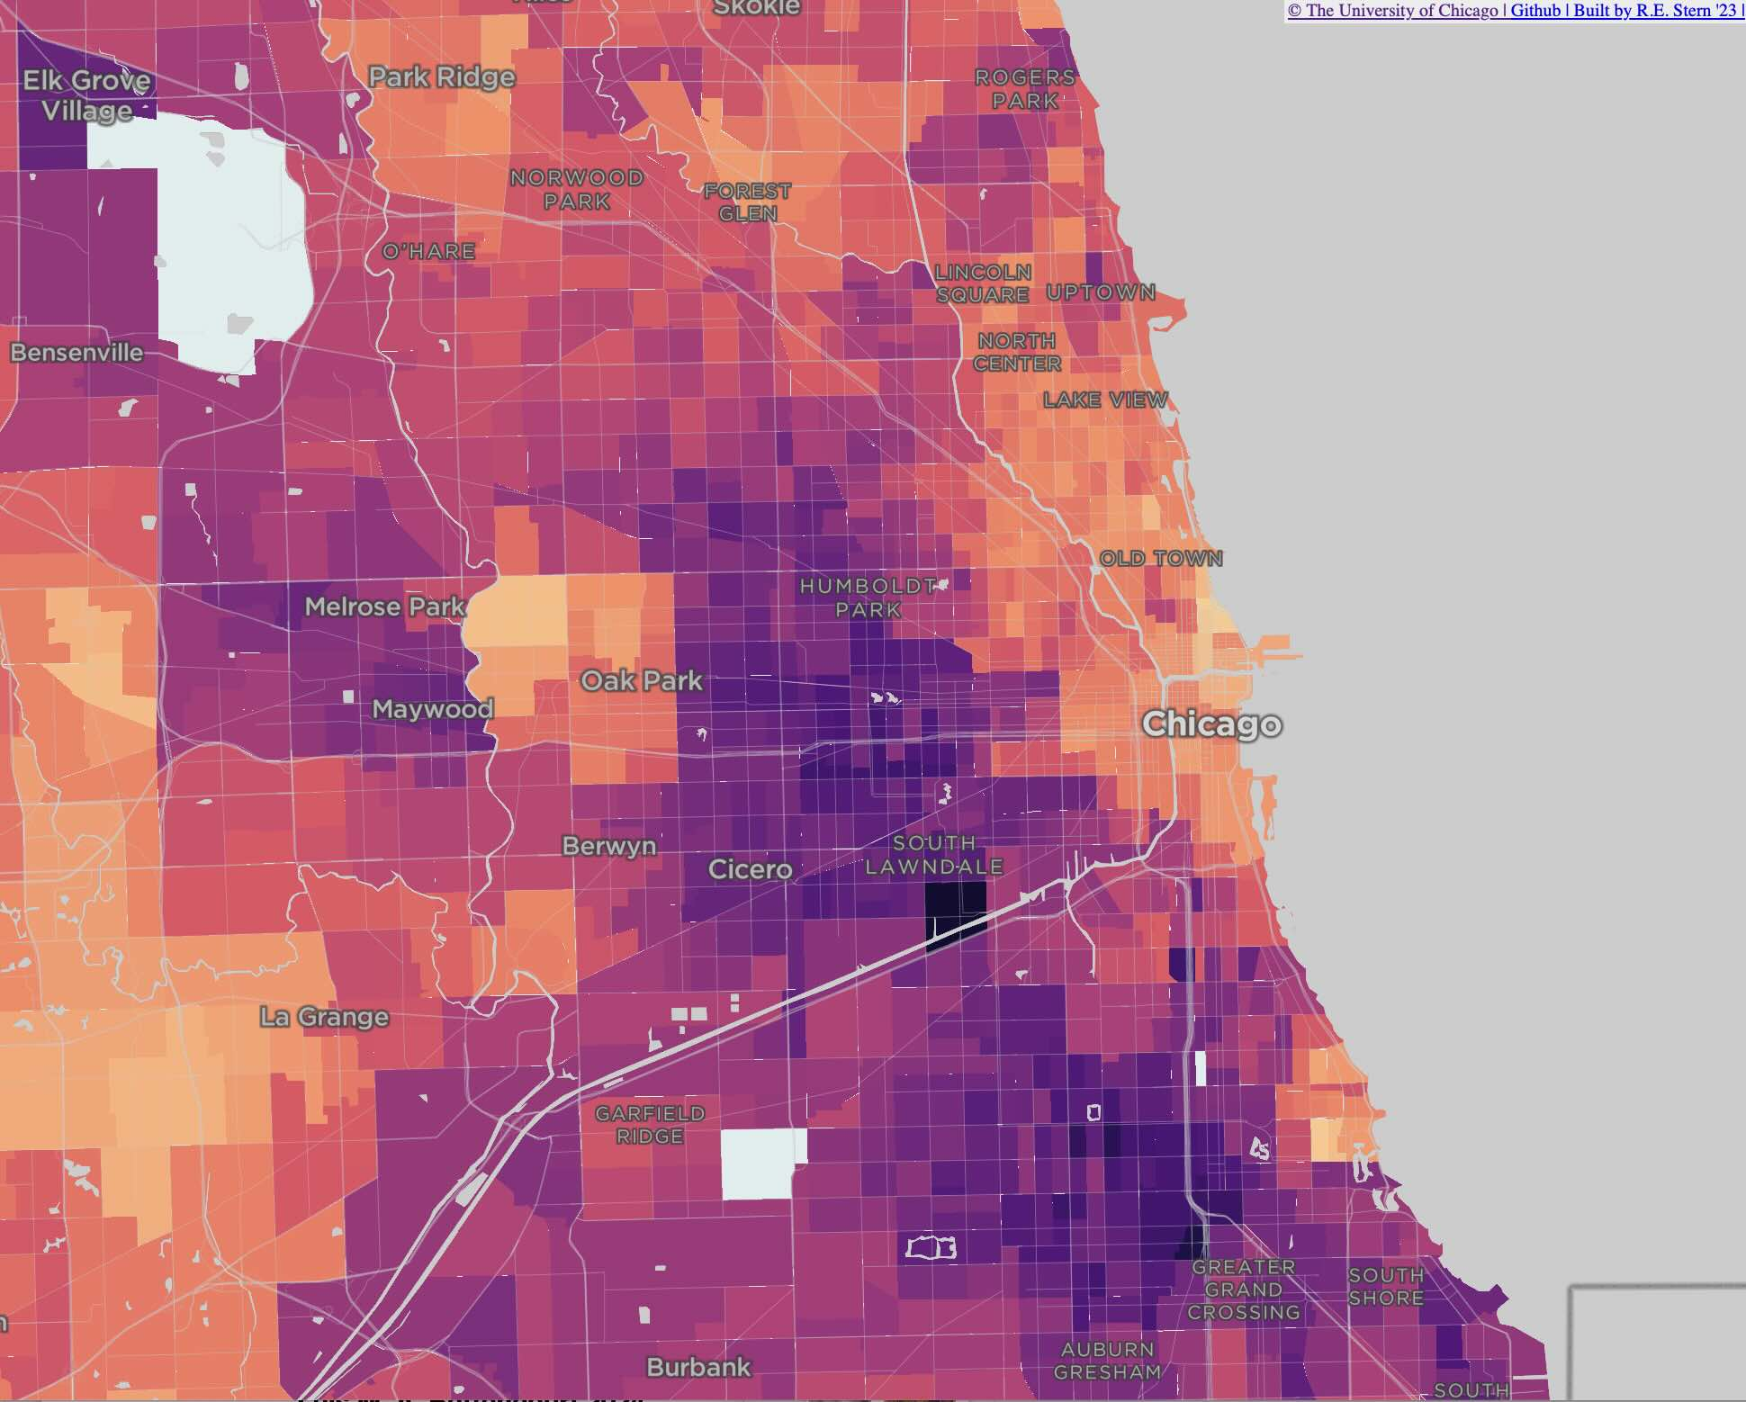
Where are the two biggest gradients?
Why?

Slide 46
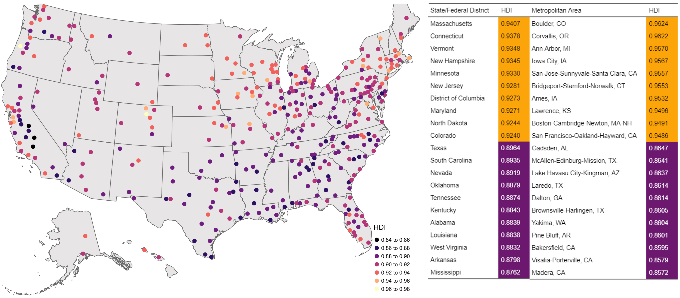
https://www.nature.com/articles/s42949-023-00088-y

Slide 47

Check it out:
https://communityhdi.org/

Slide 48
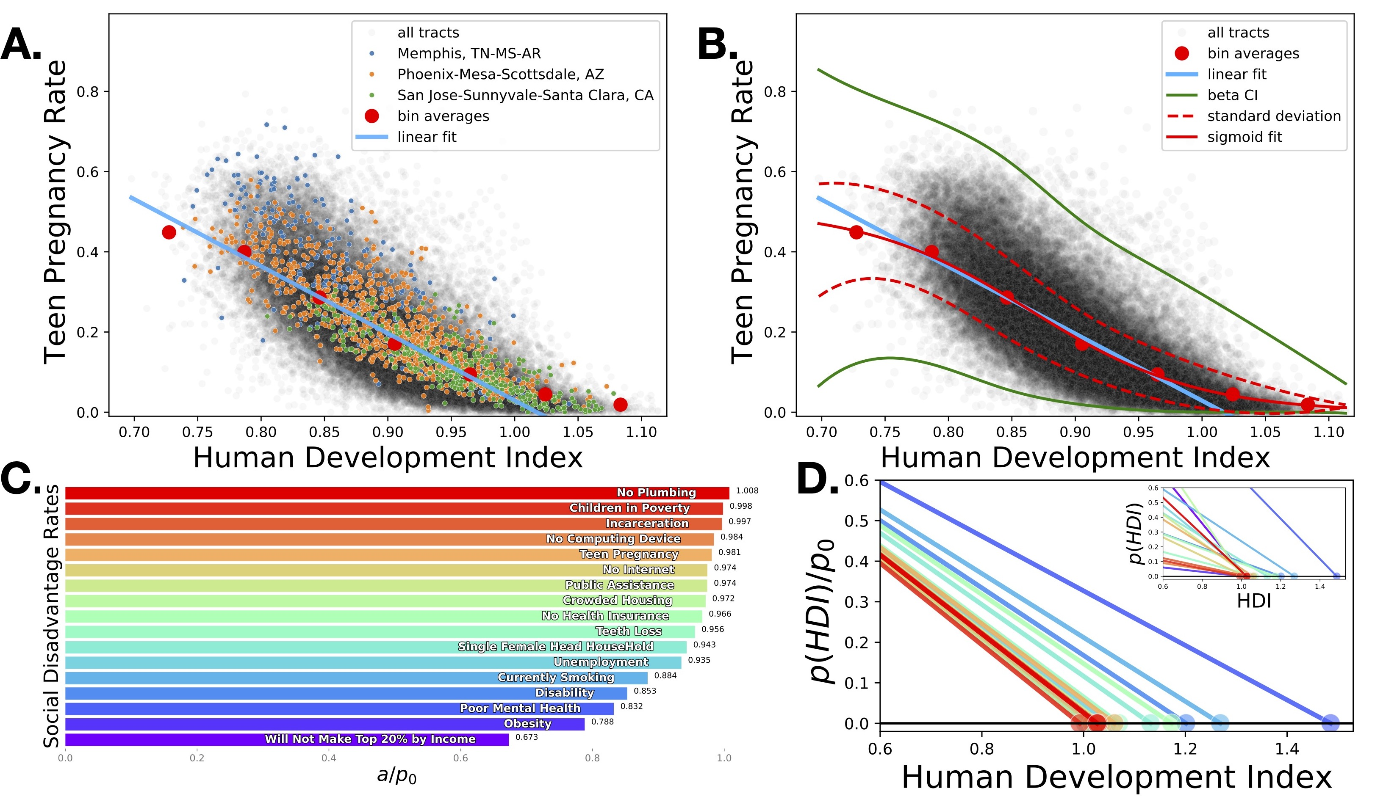
https://papers.ssrn.com/sol3/papers.cfm?abstract_id=3961750

Slide 49
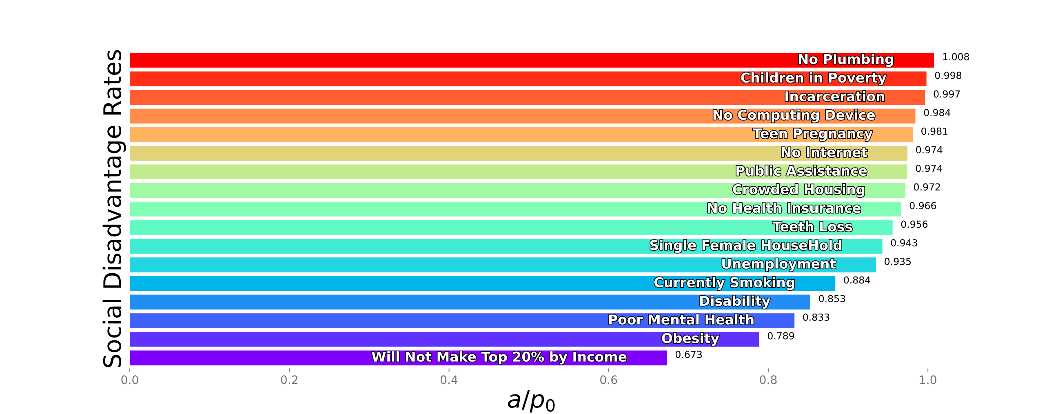
“Anna Karenina Principle” of Human Development
A deficiency in any one of a number of factors dooms an endeavor to failure.
Consequently, a successful endeavor (subject to this principle) is one for which every possible deficiency has been avoided.
https://en.wikipedia.org/wiki/Anna_Karenina_principle
All high human development communities are alike (“no problems”);
but each low human development community is challenged in its own way
Safety
Child Care
Clean Air
Job
Recreation
Water
Shopping
Health
Housing
Education
Transportation
Nature
All vary together with human development
Solution: ensure systemic human capabilities = education and health and decent real income

